Slide 1

ARTIFICIAL INTELLIGENCE FOR HOUSESTAFF
ARTIFICIAL INTELLIGENCE FOR HOUSESTAFF

Slide 2
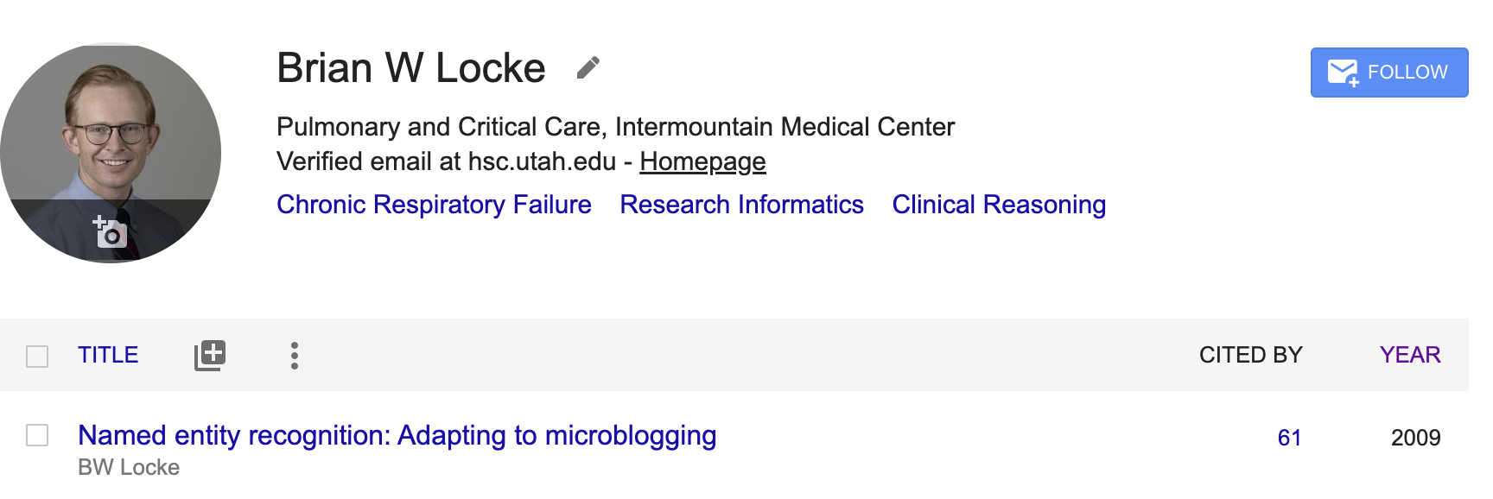
BSc in computer science (2009).
(=Twitter)
Goal 1: Demystify LLMs (etc.) work
Goal 2: Current uses
Goal 3: Pitfalls
Disclosure: I claim equity in Mountain Biometrics, Inc., a local startup using machine learning on continuous sensor data to detect decompensation and withdrawal in lightly monitored settings.
Notes:
It’s not magic, but it is pretty damn cool.

Slide 3
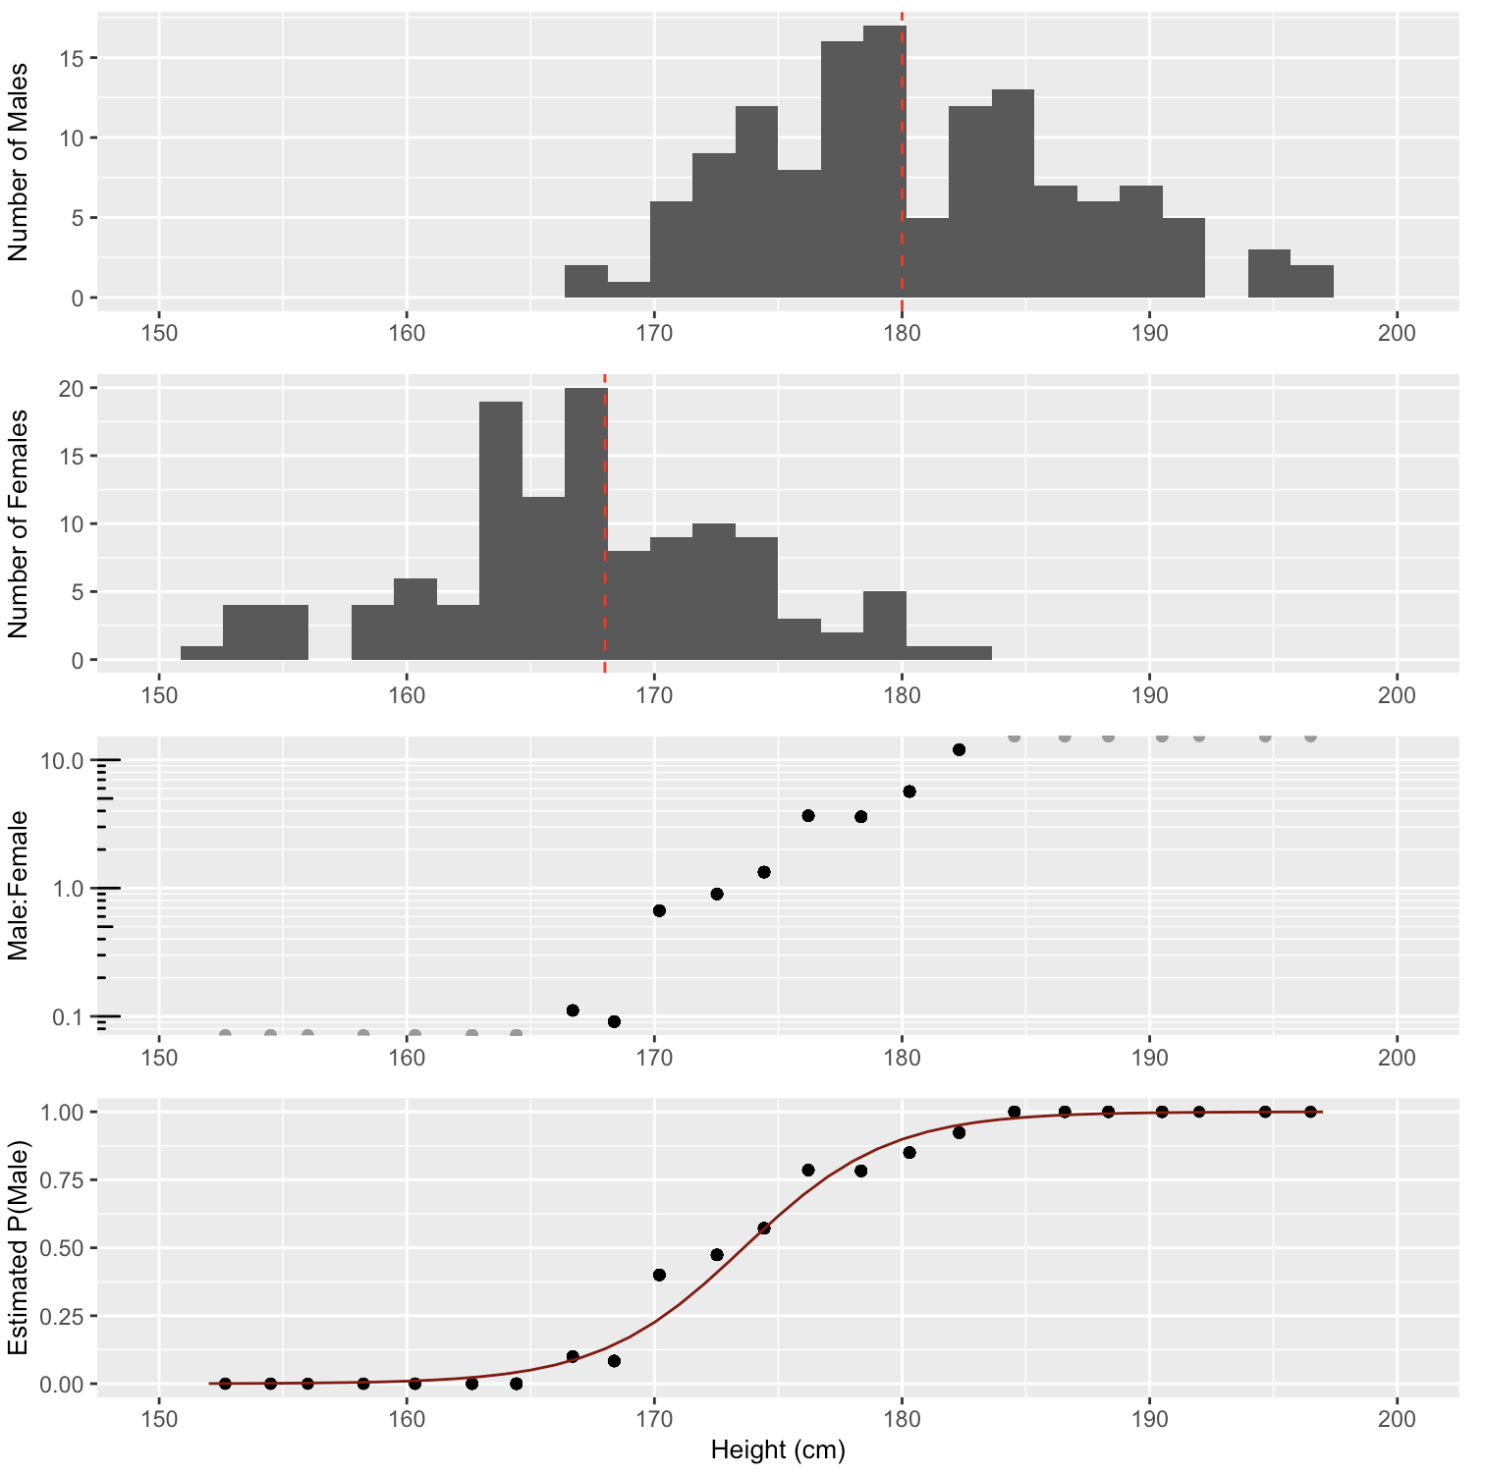
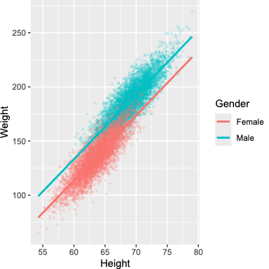
What is machine learning?
Need to know if M/F (labels)
man
woman
Logistic Regression
Linear Regression
Notes:
Supervised learning = predict answers which are labeled .

Slide 4

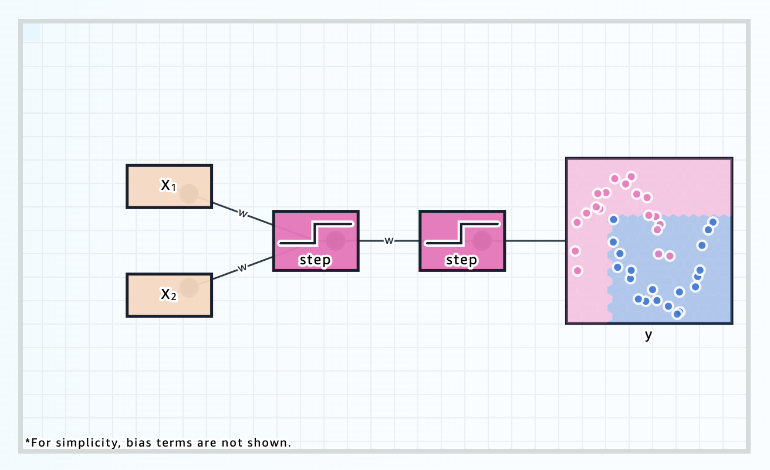
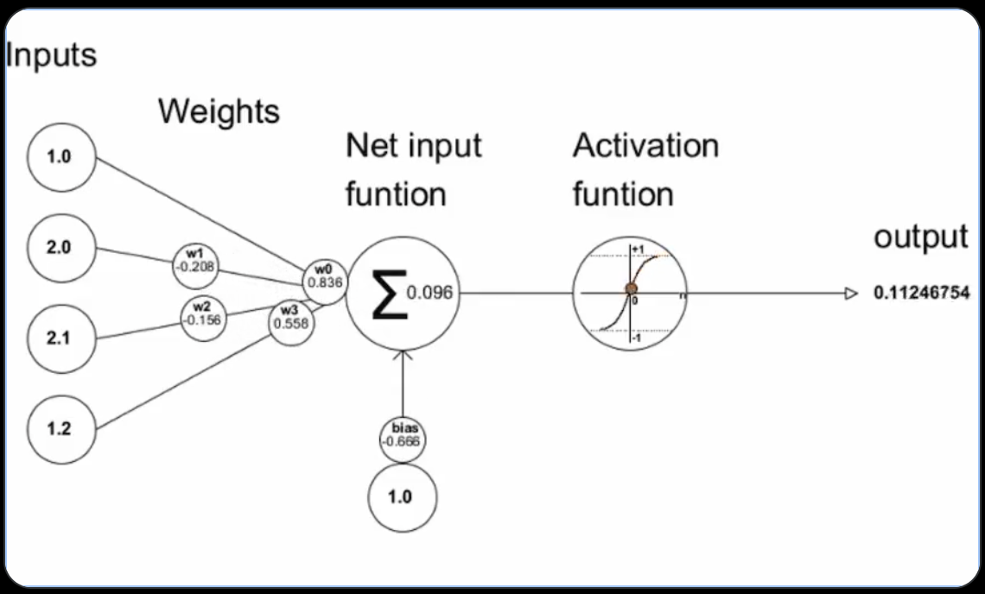
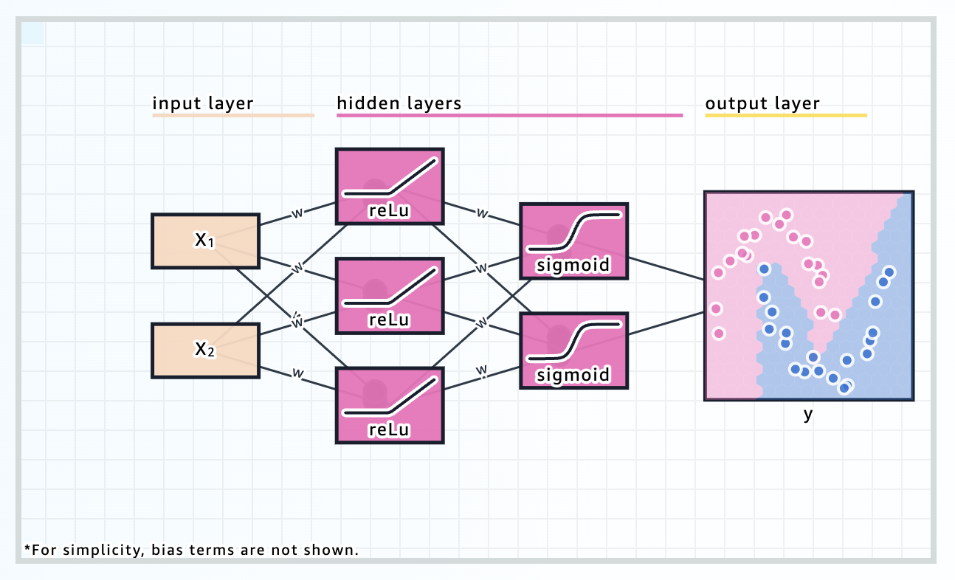
Neural Networks
Perceptron
https://mlu-explain.github.io/
Parameters
Notes:
https://mlu-explain.github.io/neural-networks/
Neural network: computing systems inspired by biological neural networks, comprising ‘perceptrons’ (nodes), usually arranged in layers, communicating with one another and performing transformations upon input data.
Parameter: a variable within a machine learning model that is tuned — usually automatically — during training to maximize performance. In deep learning, parameters are the ‘weights’ or data transforming functions comprising neural network nodes.
Neural networks -> Convolutional neural networks and recurrent neural networks -> Transformers.
Feed forward network?
Neural networks were good because you can use GPUs (several calculations simultaneously) - this is why NVIDIA went from a company only video game nerds cared about to one of the major global players.
However - they don’t do well with context/references that are not nearby in the text - which is where transformers come in.
Neural networks: Systems inspired by the neuronal connections in the brain that are capable of learning, recognizing patterns, and making predictions on tasks without explicit programming. They are the building blocks of many modern machine-learning (deep-learning) algorithms.

Slide 5
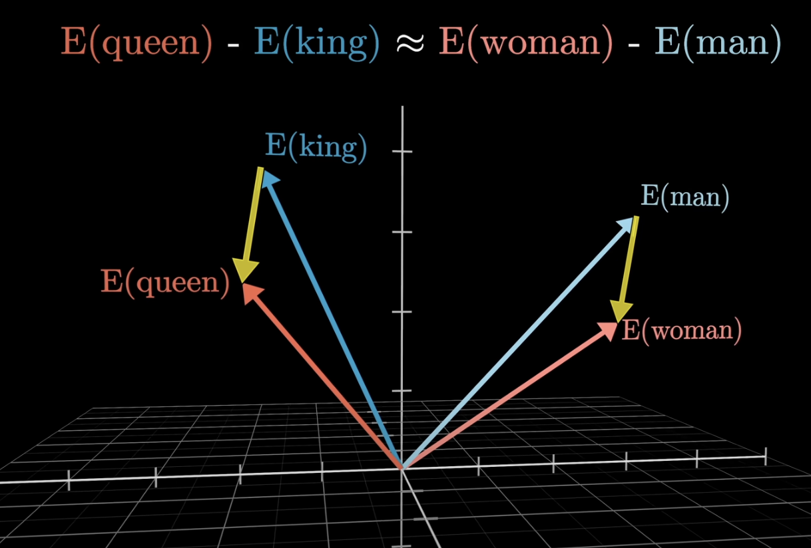
Embeddings: represent the meaning of text with numbers (‘word vectors’)
Notes:
https://www.youtube.com/watch?v=wjZofJX0v4M
Very good explainer: https://writings.stephenwolfram.com/2023/02/what-is-chatgpt-doing-and-why-does-it-work/
Another explainer https://stackoverflow.blog/2023/11/09/an-intuitive-introduction-to-text-embeddings/?utm_medium=email&utm_source=substack
Strictly, ChatGPT does not deal with words, but rather with “tokens”—convenient linguistic units that might be whole words, or might just be pieces like “pre” or “ing” or “ized”. Working with tokens makes it easier for ChatGPT to handle rare, compound and non-English words, and, sometimes, for better or worse, to invent new words.

Slide 6
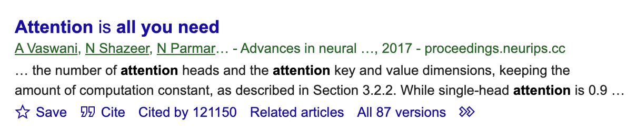
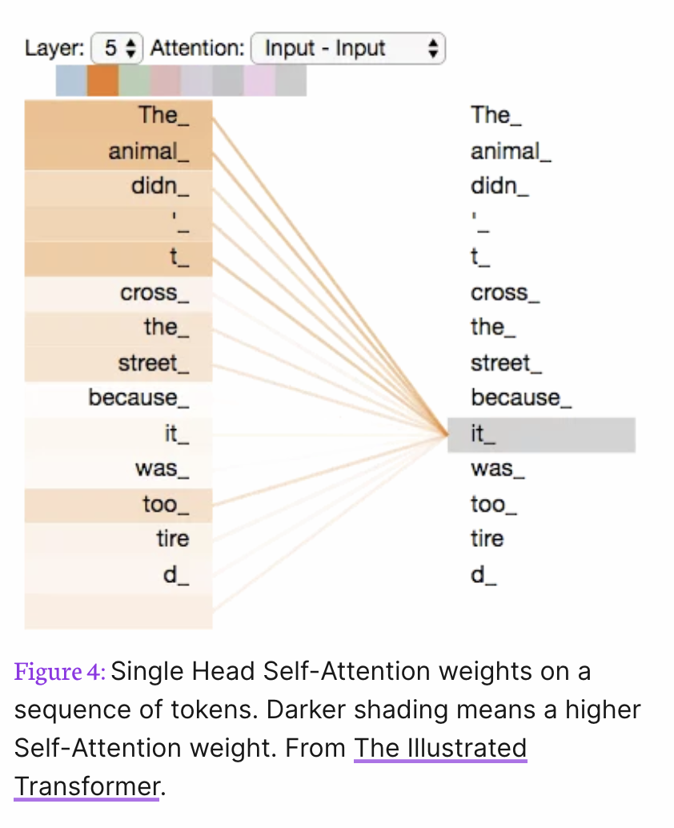
Transformer Models:
Variant of neural network + attention = Transformer
Context window = how big the attention frame is
This, and overall model size, are the main metrics of performance.
Notes:
LLM - feed forward neural network = basically google n-grams (old idea)
+Add Self-attention (context),
Attention: A mechanism within the Transformer architecture that enables the differential weighting mentioned above.
Akin to how a physician identifies important details of a patient's case while ignoring extraneous information, this mechanism enables LLMs to “learn” important relationships between words while ignoring irrelevant information.
Transformer: A deep-learning model architecture that relies on self-attention mechanisms by differentially weighting the importance of each part of the model’s input. This makes it particularly useful for language tasks.
(title is currently some phenol reagent paper that has 300k citations from the 1970s… trajectories will cross)
NeurIPS conference paper! 5 years, 100K+ citations.
(to be fair NeurIPS has a higher impact factor than JAMA…)
"Attention Is All You Need" is a landmark^{[1][2]} 2017 research paper authored by eight scientists working at Google, responsible for expanding 2014 attention mechanisms proposed by Bahdanau et al. into a new deep learning architecture known as the transformer. The paper is considered by some to be a founding document for modern artificial intelligence, as transformers became the main architecture of large language models.^{[3][4]} At the time, the focus of the research was on improving Seq2seq techniques for machine translation, but even in their paper the authors saw the potential for other tasks like question answering and for what is now called multimodal Generative AI.^{[5]}
The paper's title is a reference to the song "All You Need Is Love" by the Beatles.^{[6]}
As of 2024, the paper has been cited more than 100,000 times.^{[7]}
Deep learning: a variant of machine learning involving neural networks with multiple layers of processing ‘perceptrons’ (nodes), which together facilitate extraction of higher features of unstructured input data (for example, images, video and text).

Slide 7
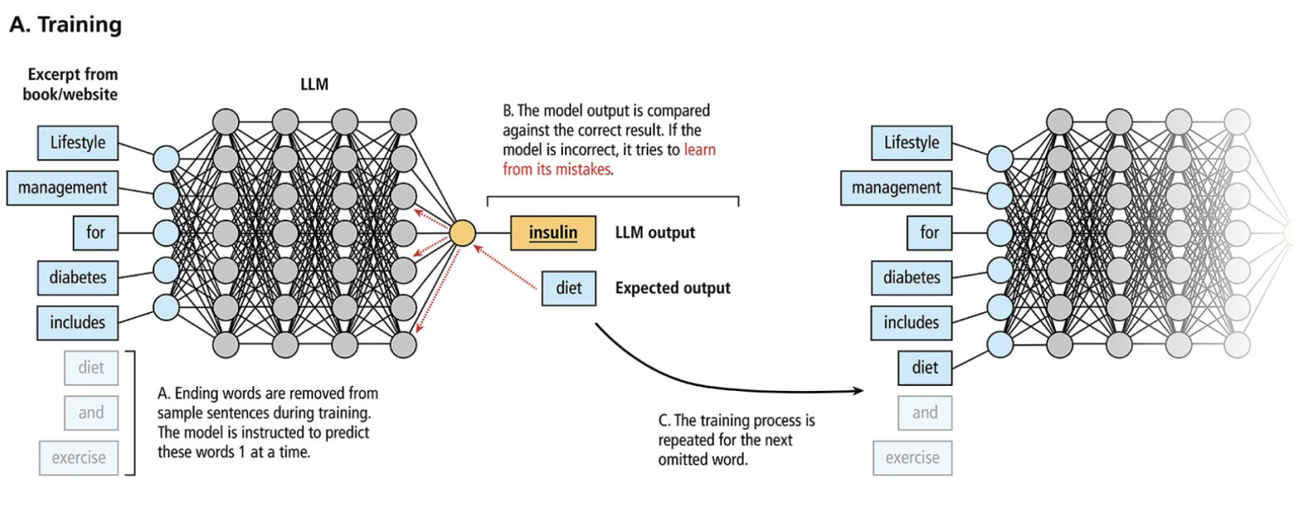
What is a large-language model (LLM)?
Foundational model trained on an enormous amount of text
Notes:
Embeddings = vector associated with each token that encapsulates its meaning. Transformer actually works on the embeddings, not the tokens directly.
Projections: hidden states -> softmax = probabilities for every word in the vocabulary -> a variety of ways to choose how to do this. (e.g. greedy - choose the highest)
“LLMs are large-scale language models trained on massive corpora of text with millions of trained parameters allowing for the processing and “understanding” of human-generated text. LLMs have recently generated significant attention for their range of functionality including prediction/classification tasks, text summarization, and the generation of responses to user prompts”
Citation as above. https://www.ccjm.org/content/91/3/173
“LLMs are large-scale language models trained on massive corpora of text with millions of trained parameters allowing for the processing and “understanding” of human-generated text. LLMs have recently generated significant attention for their range of functionality including prediction/classification tasks, text summarization, and the generation of responses to user prompts”

Slide 8
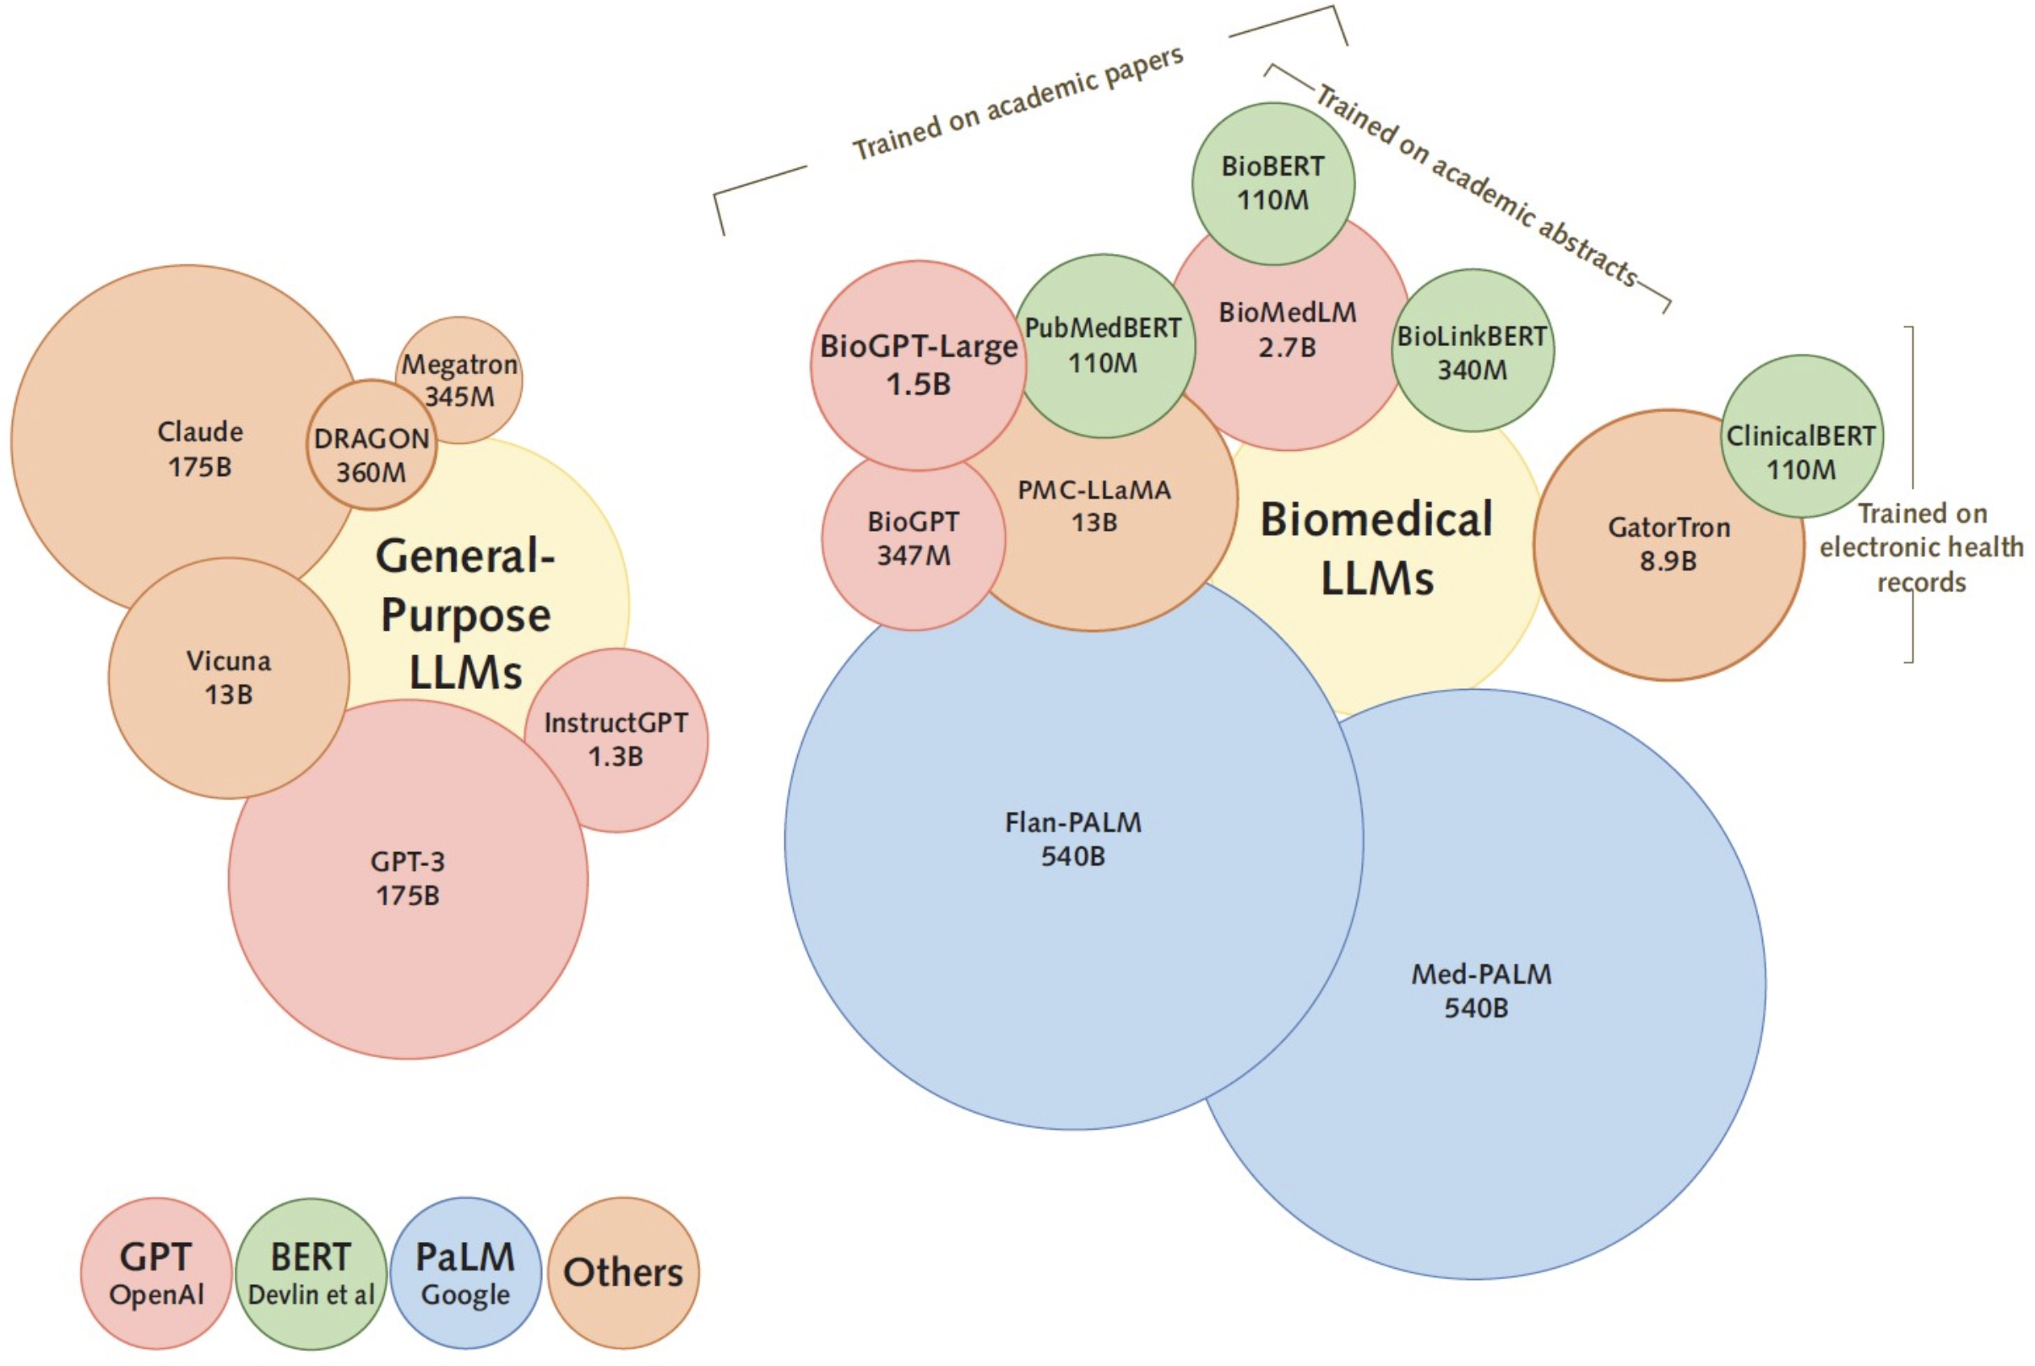
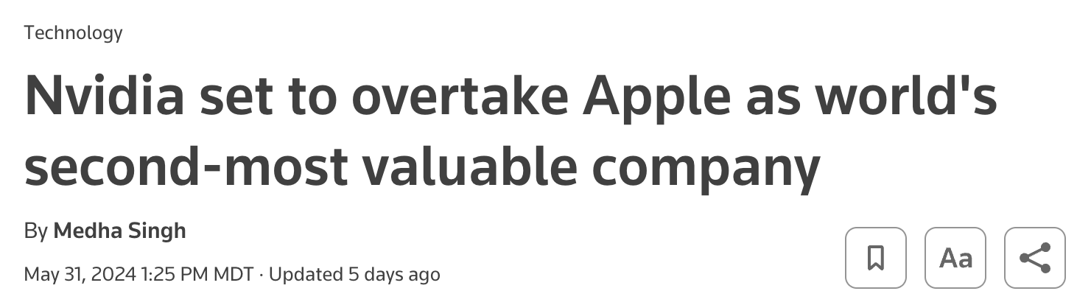
What does this enable?
Parallel processing on GPUs (instead of CPUs)
You can make HUGE models [e.g. the entire internet]
1. predict the next token [~word]
2. See if you were right
3. re-weight parameters to improve
4. repeat for billions of times
Notes:
https://cameronrwolfe.substack.com/p/summarization-and-the-evolution-of?utm_medium=email&publication_id=1092659&triedRedirect=true evolution of LLMs
GPUs
https://www.reuters.com/technology/nvidia-set-overtake-apple-worlds-second-most-valuable-company-2024-05-31/

Slide 9
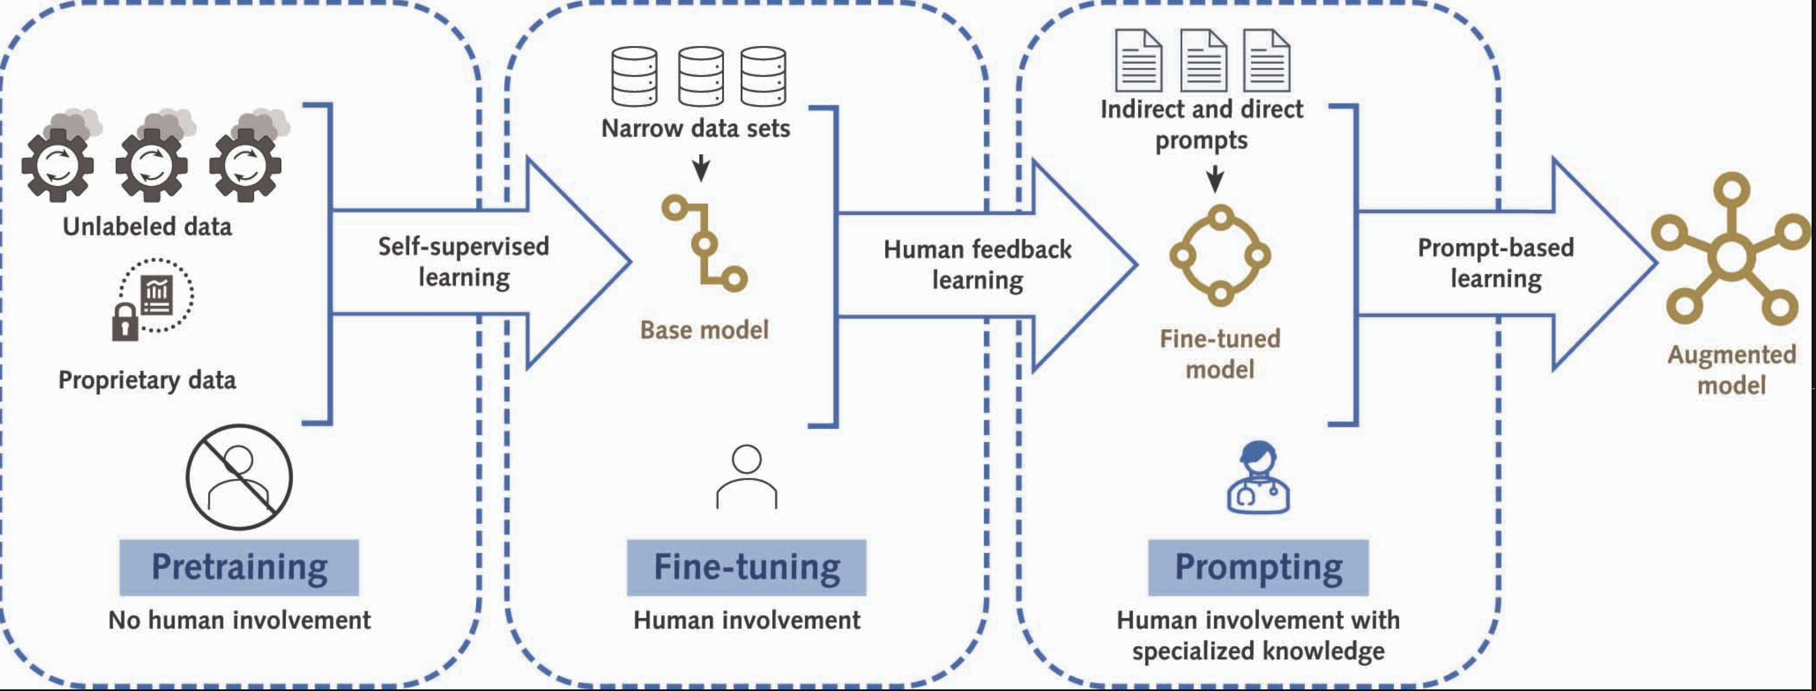
Transfer learning: (this is the secret sauce)
Previously: define a task, label a set to train the model in (expensive) and then evaluate it’s performance. Repeat. $$$
limited by the amount of annotated data.
Now: ”Pre-train” (= unsupervised learning) on a huge amount of data to learn general data – termed a foundational model. Do this once ($$$)
Can do tasks not in the training data (actual learning)
Notes:
Pretraining: The initial phase of training a model on a large data set before fine-tuning it on a task-specific data set. The parameters are updated in the training process.
Fine-tuning: Further training a pretrained model on a specific task and adjusting the preexisting parameters to achieve better performance for a particular task.
Unsupervised Pre-training - expose it to a huge amount of text, so that it can learn the probabilities of the next words.
“During pretraining, neural LMs are trained to learn the general structure of written content by performing basic tasks such as predicting a word hidden in a sentence or if two sentences precede each other;” Linguistic features, syntactic and semantic relationships.
—> then, you fine-tune on a smaller training data set of interest to do the task hat you want.
Further training: = reinforcement learning (don’t say racist things or tell people how to commit crimes)
https://arxiv.org/abs/2303.12712
Why does this matter?
You get something called transfer learning… if you can predict the next word sooo well, you start to get generalizable knowledge. -> surprising.
This means that you can just train an extremely large model once, but then apply it to many different tasks
(previously, you’d either need to come up with some rules on your own; or label a database on your own.. now, it’ll work fairly well on its own)

Slide 10
Review: How (and why) do LLMs work?
They are statistical machine learning algorithms called transformers (work very well on text)
Flexible machine-learning method built on neural networks
Attention mechanism allows it to handle references (context window)
Images, time-series, etc. require modified algorithms.
They learn patterns of co-occurrence in massive data sets and numerical representations of meaning.
It turns out this works well enough to apply to novel problems (transfer learning)

Slide 11
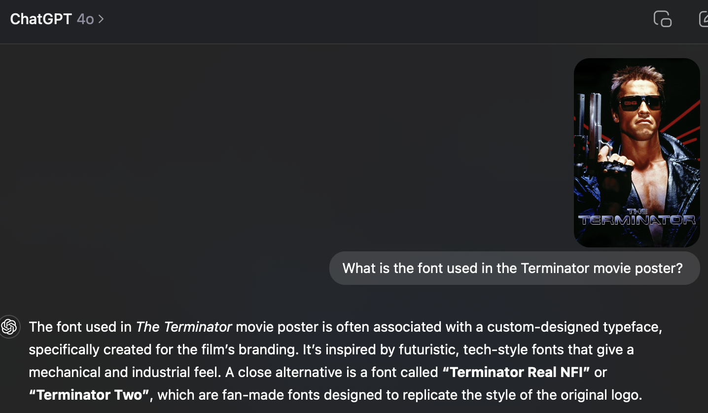
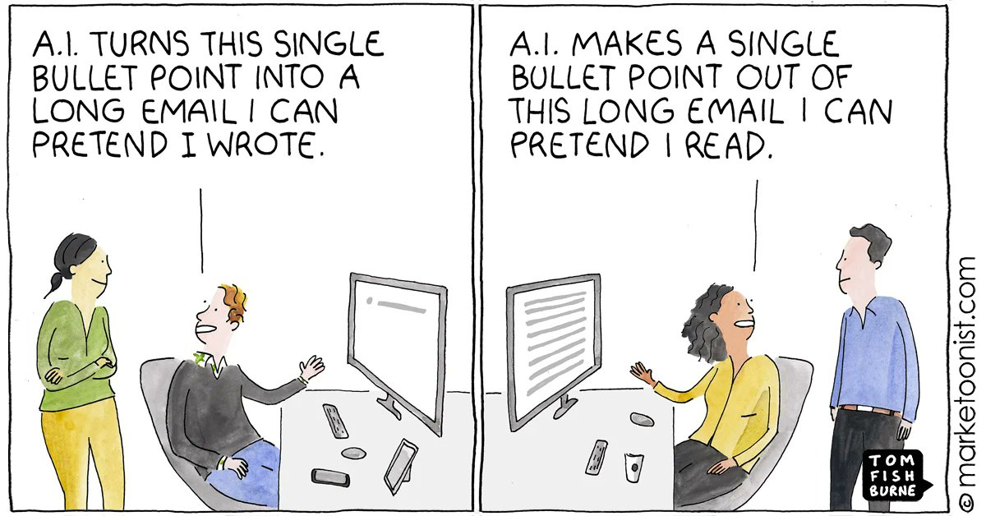
Mundane Stuff
Notes:
[ ]

Slide 12
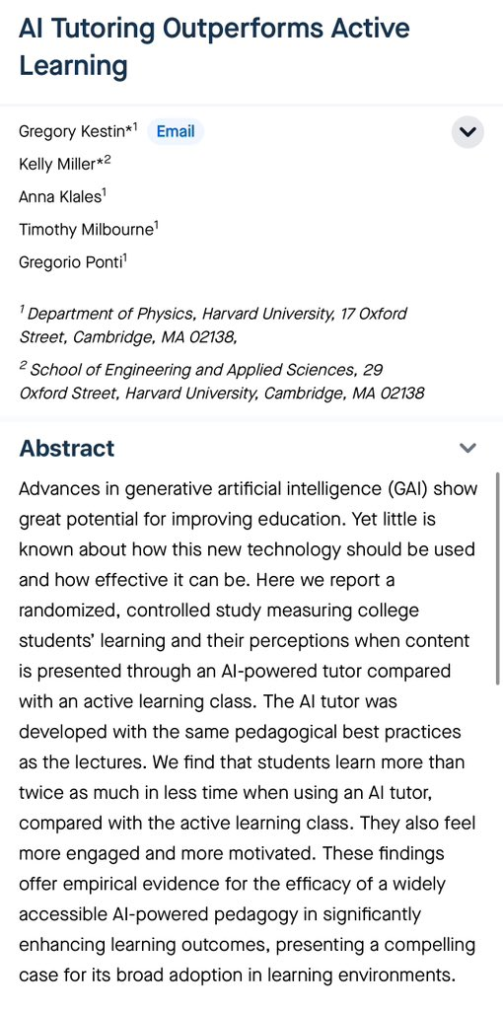
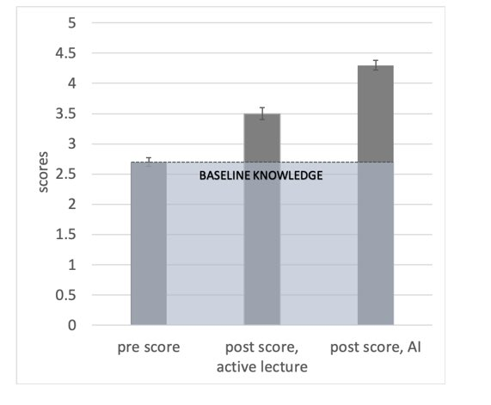
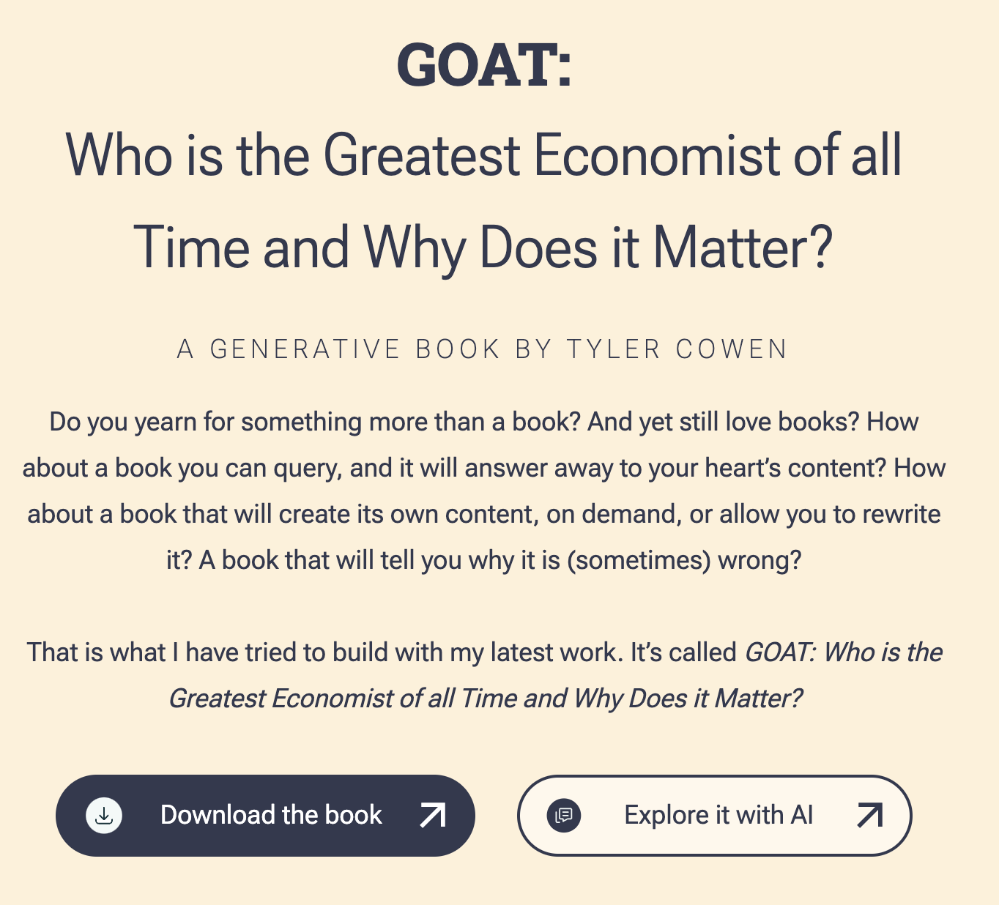
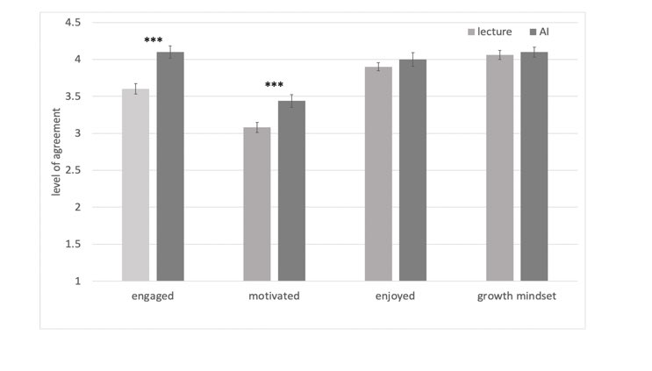

Slide 13
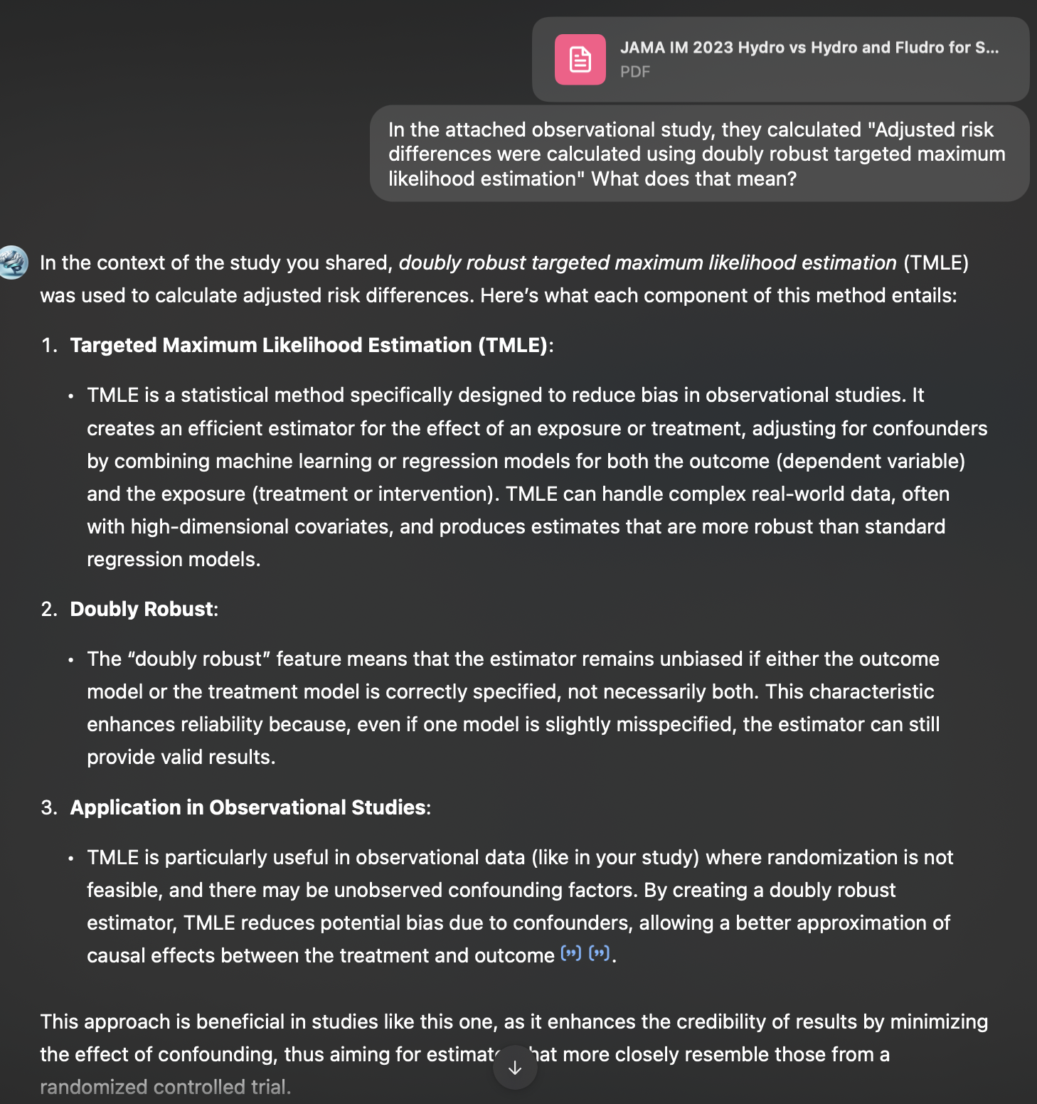
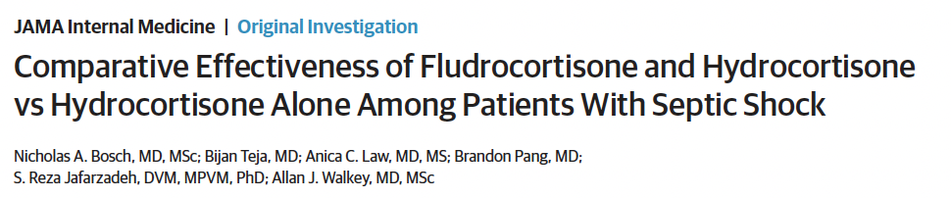
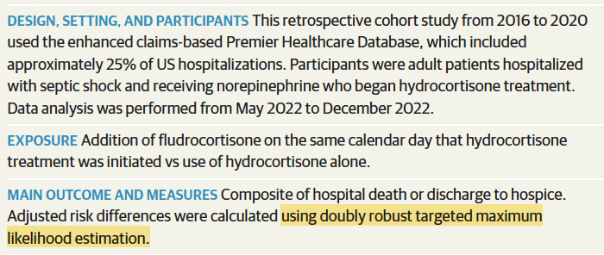

Slide 14
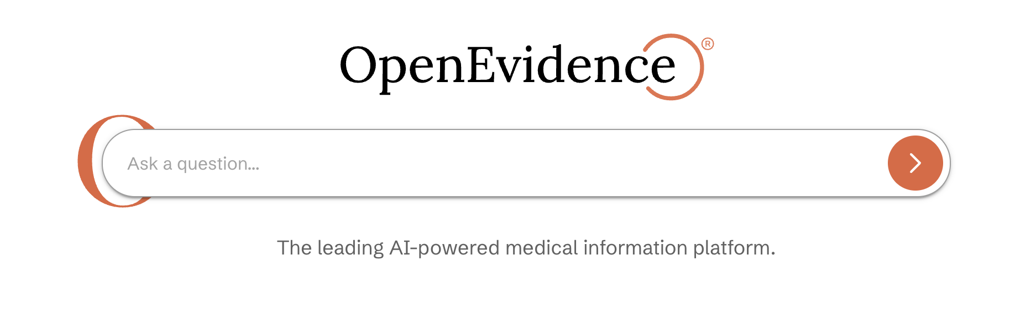

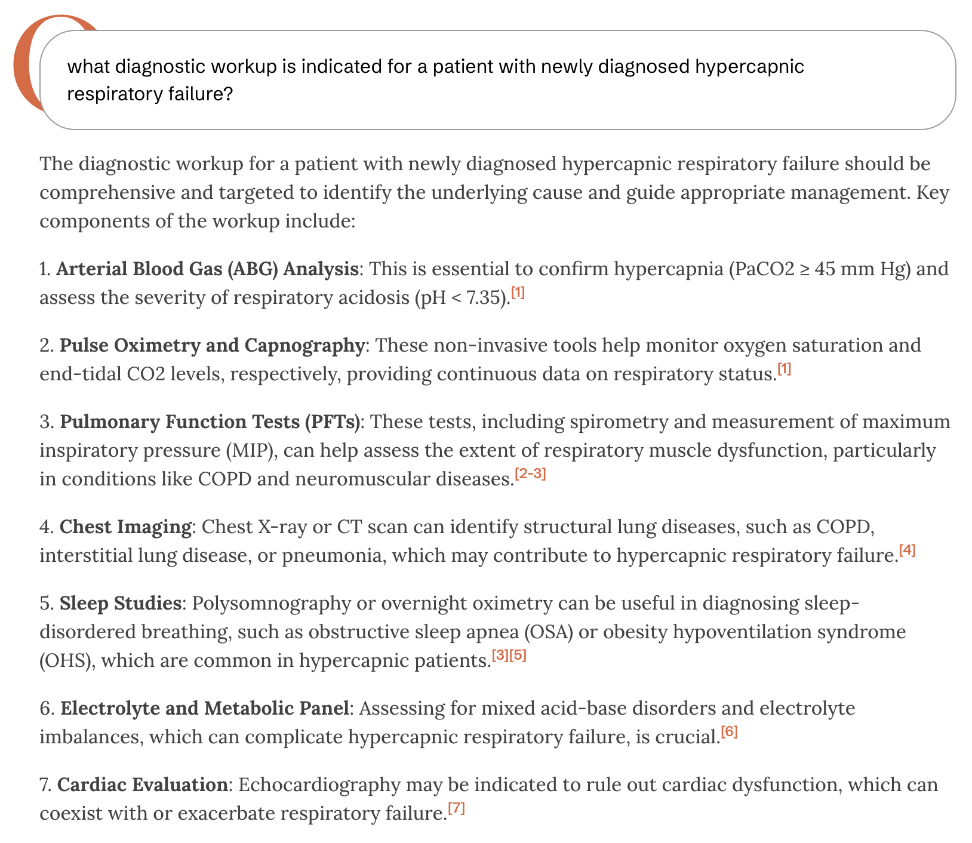
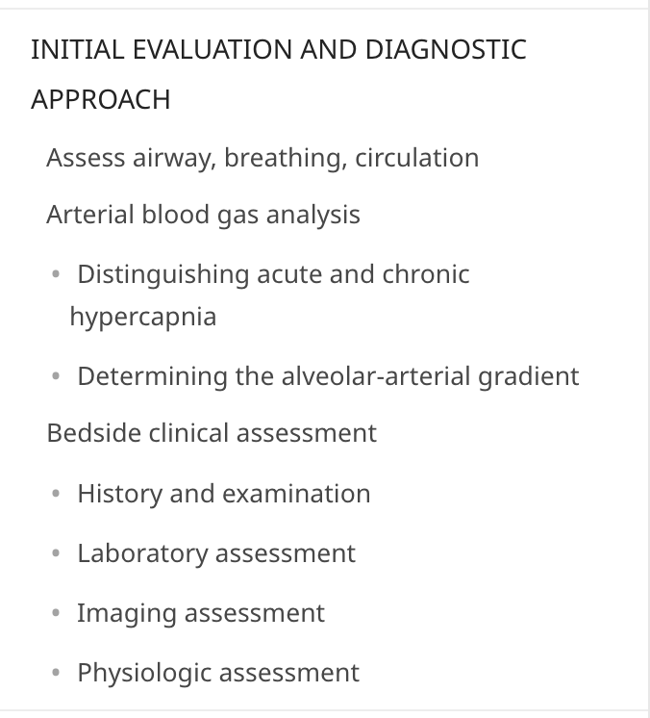

Slide 15
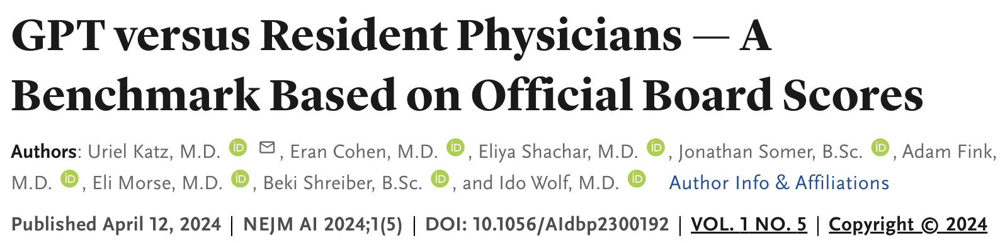
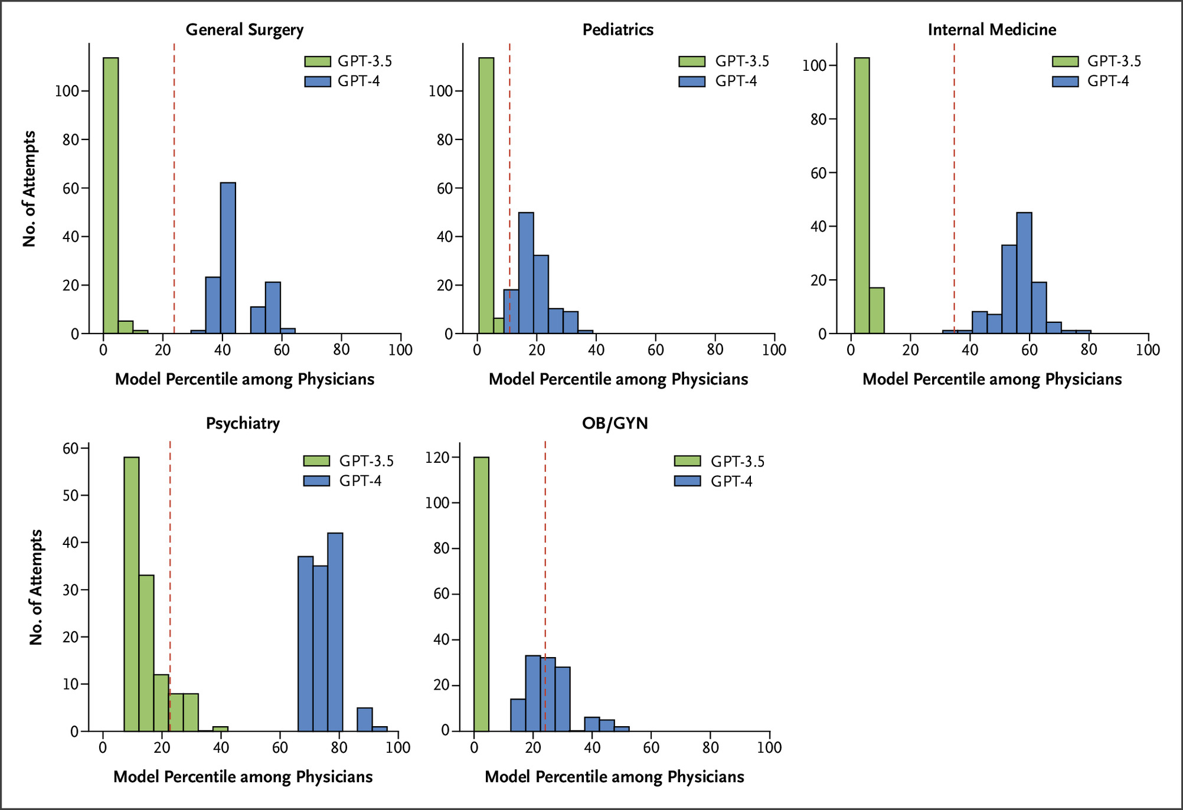
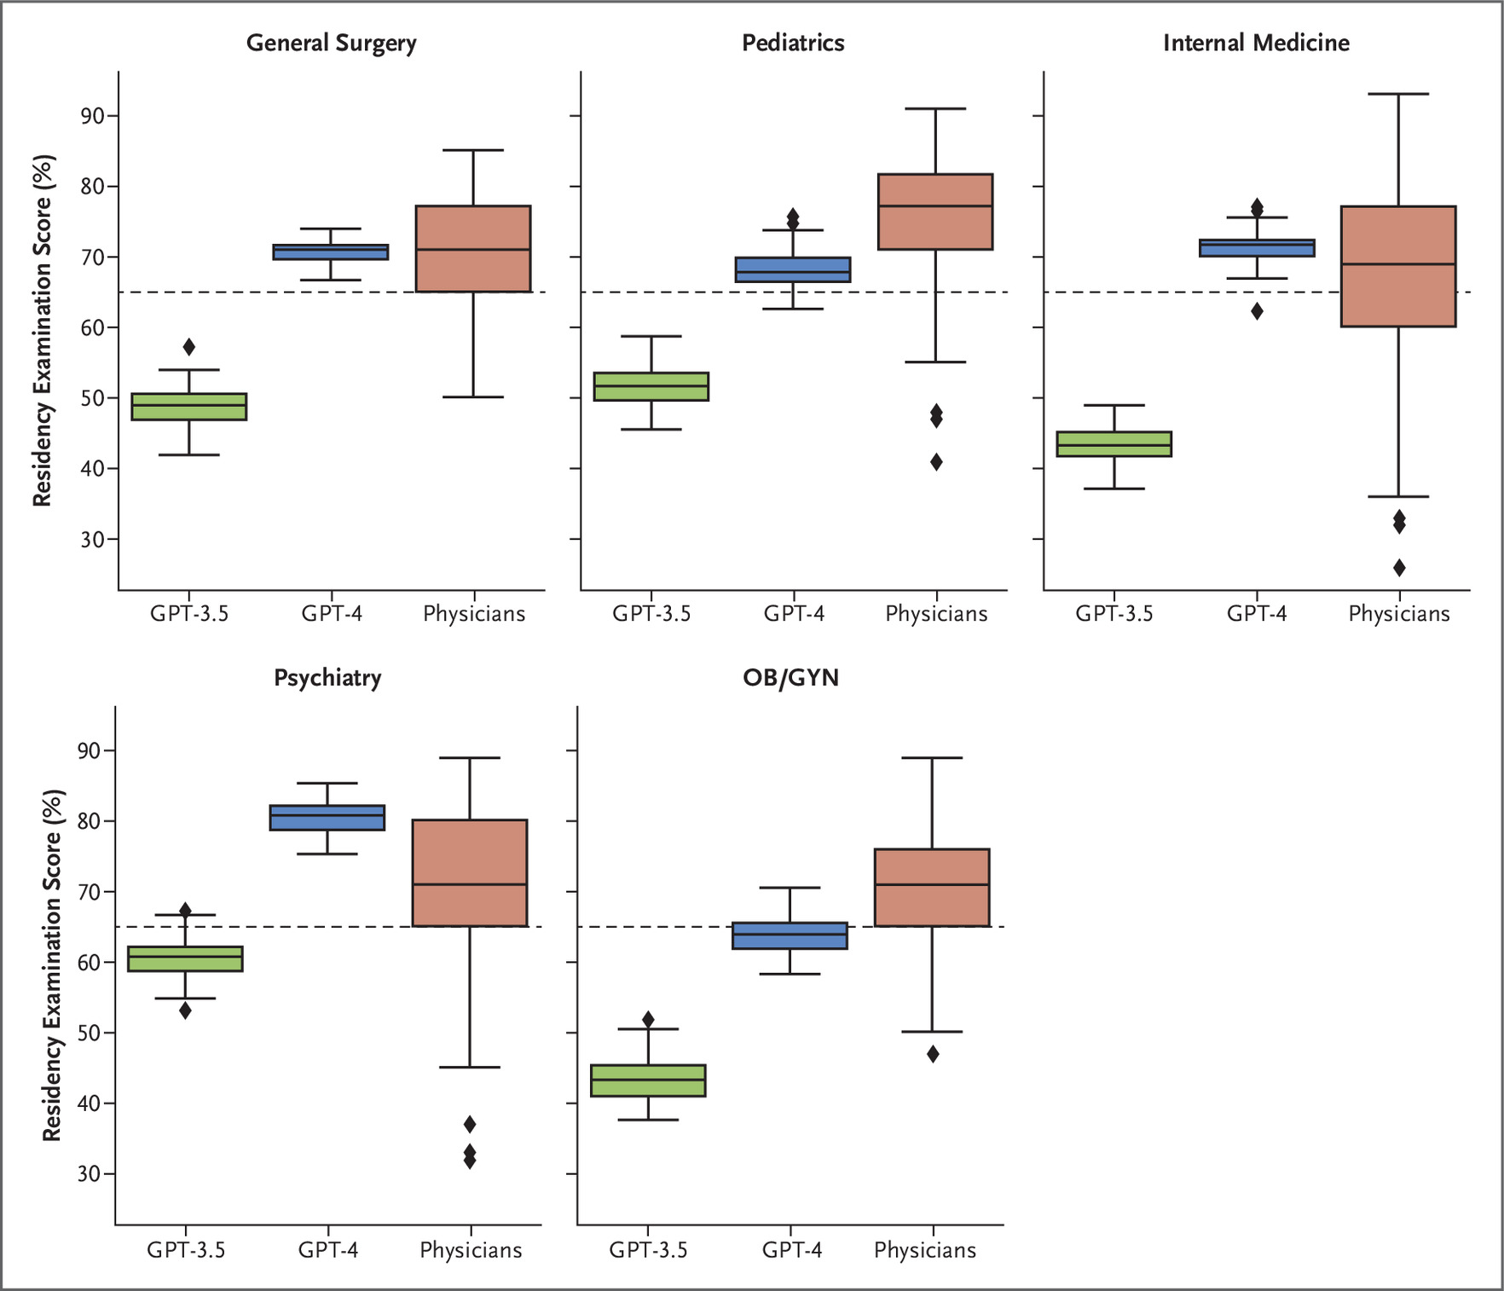
GPT 3-4 vs Physician’s on their boards (Israel)
Notes:
https://ai.nejm.org/doi/full/10.1056/AIdbp2300192#f1

Slide 16
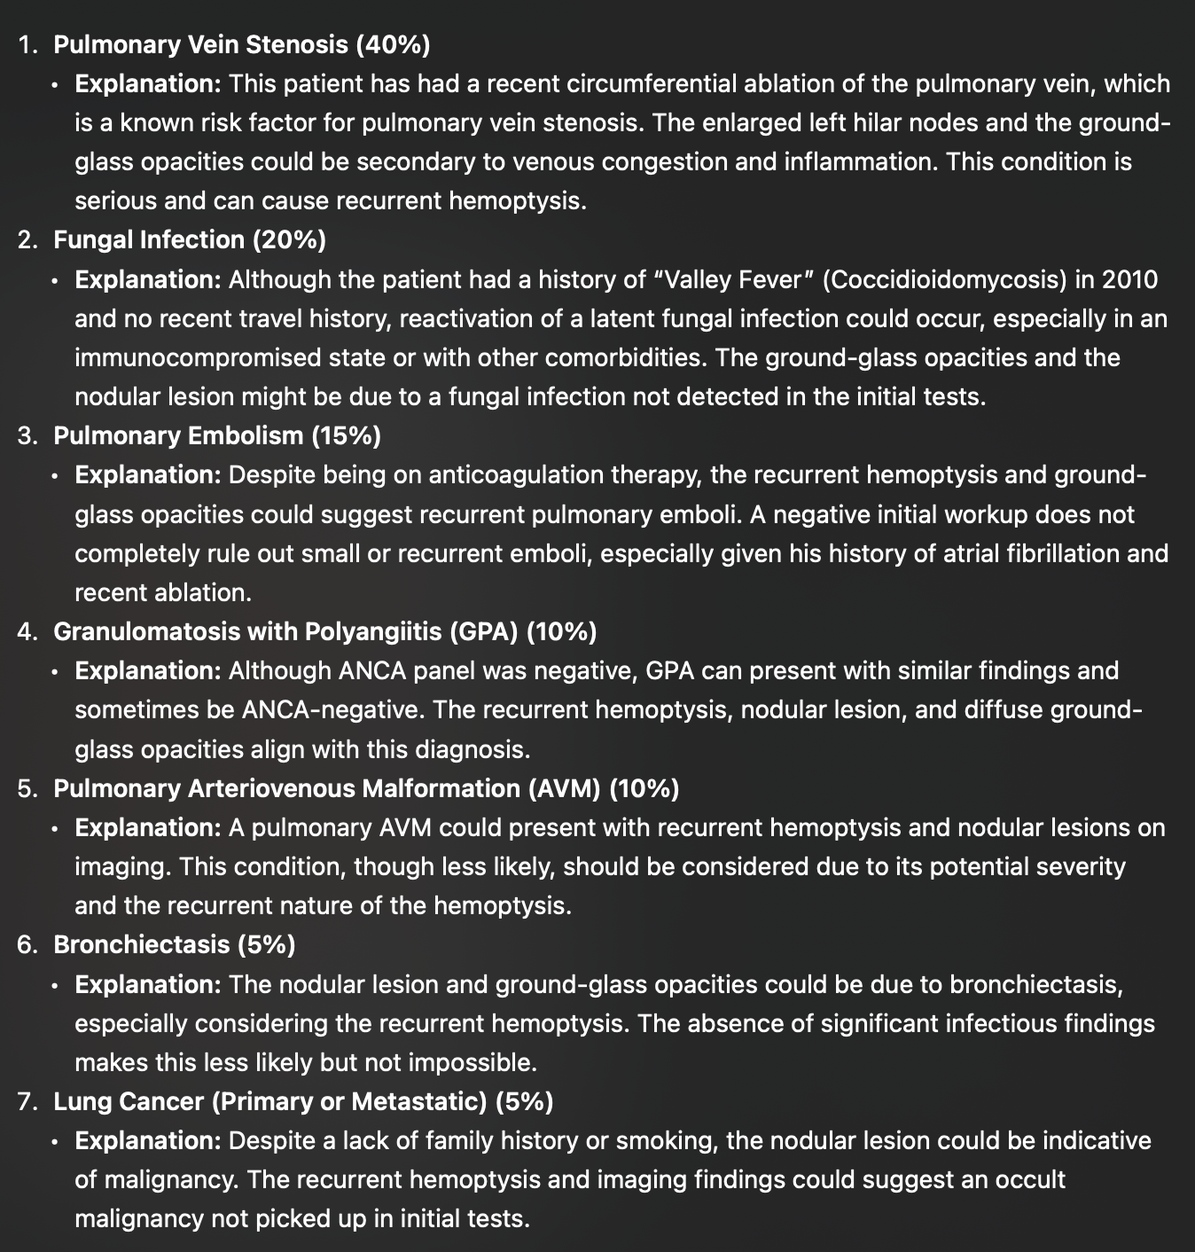
Are we going to be out of job?
Pulm/CC Case conference for recurrent hospitalizations with hemoptysis
Before vs after clarifying a recent pulmonary vein ablation
1. Bronchogenic Carcinoma (35%)
2. Recurrent Coccidioidomycosis (Valley Fever) (25%)
3. Pulmonary Tuberculosis (15%)
4. Pulmonary Vasculitis (e.g., Granulomatosis with Polyangiitis) (15%)
5. Pulmonary Embolism with Infarction (10%)

Slide 17
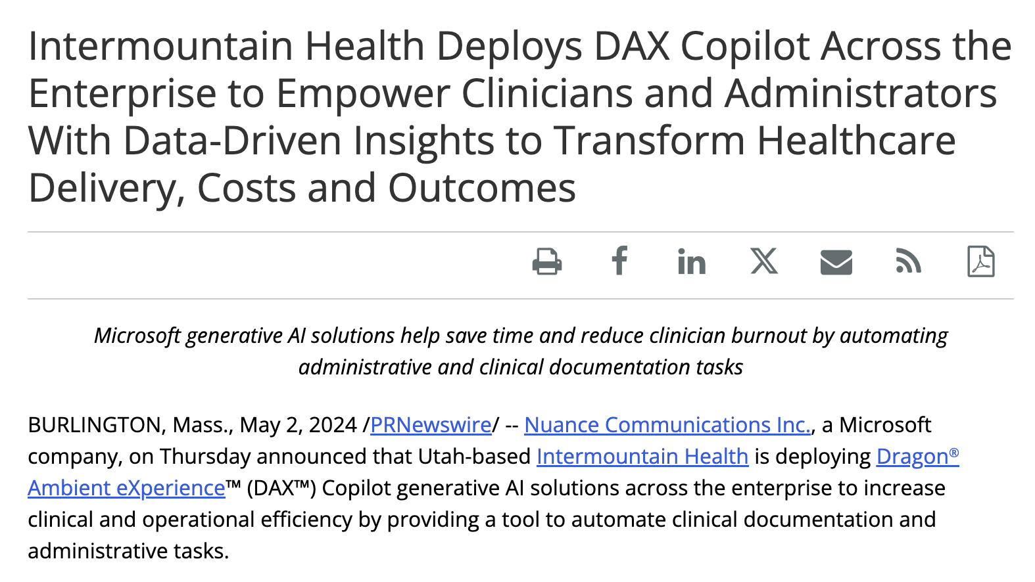
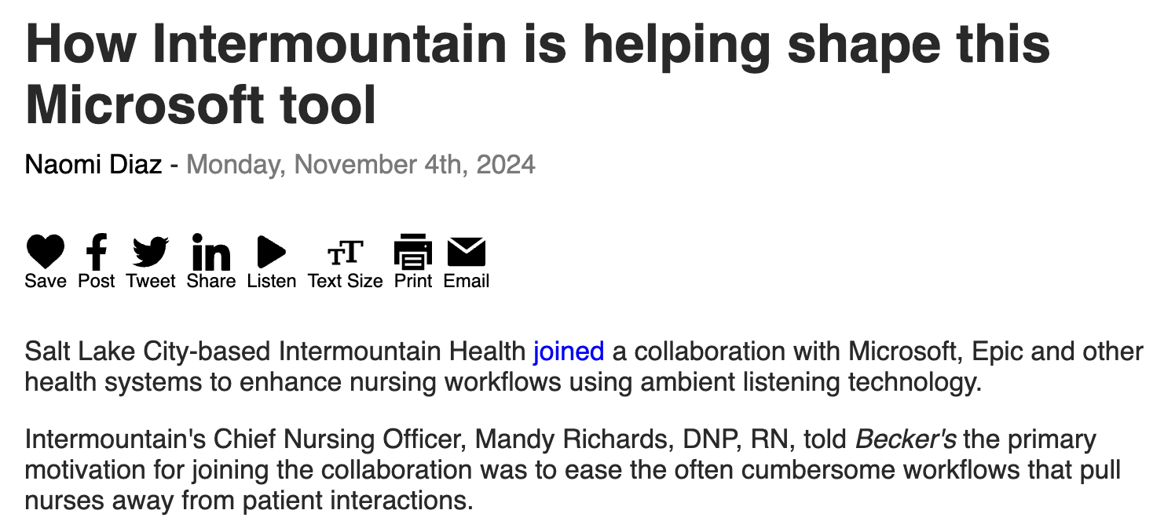
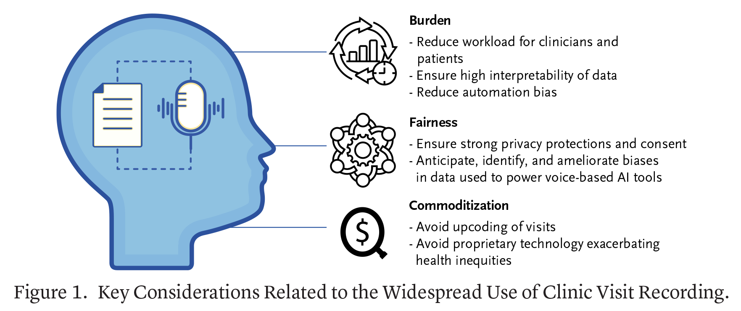
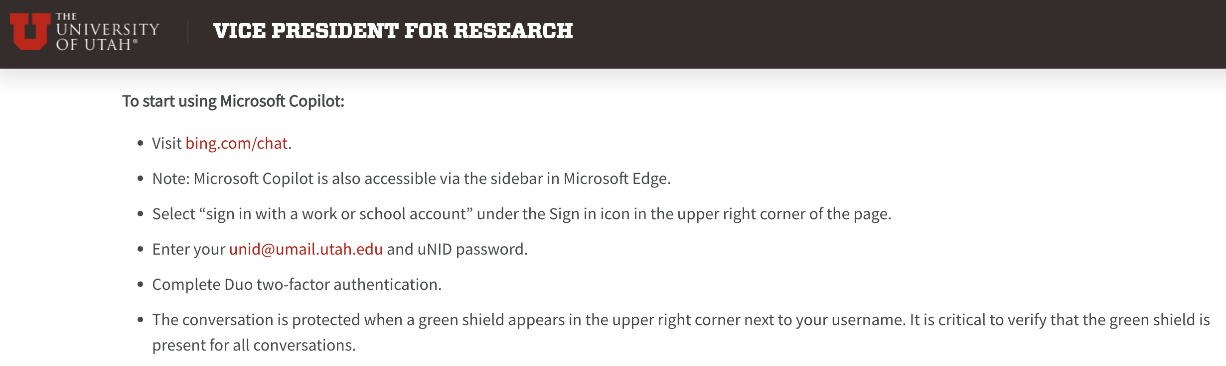
Notes:
https://x.com/NEJM_AI/status/1854906741475230111
[ ] Utah

Slide 18
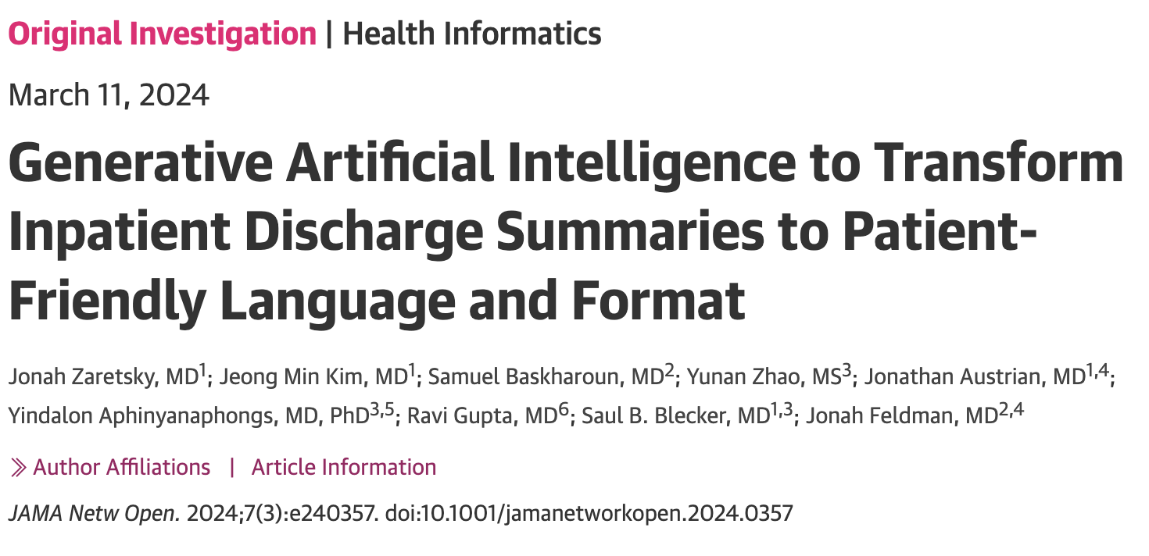
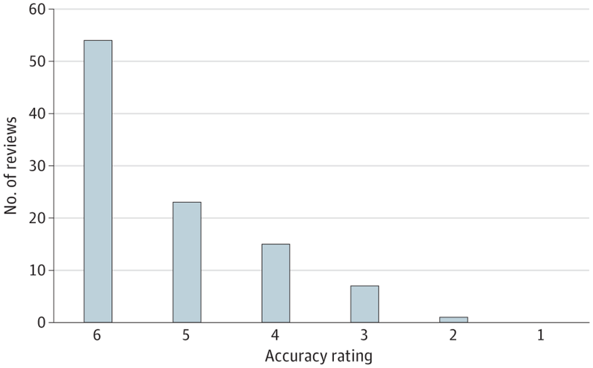
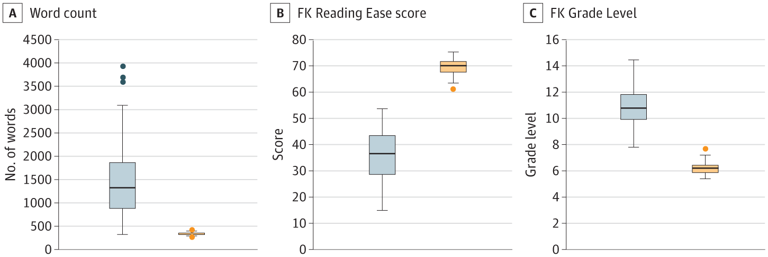
Objective To determine whether an LLM can transform discharge summaries into a format that is more readable and understandable.
Not a promising use
→less accurate

Slide 19
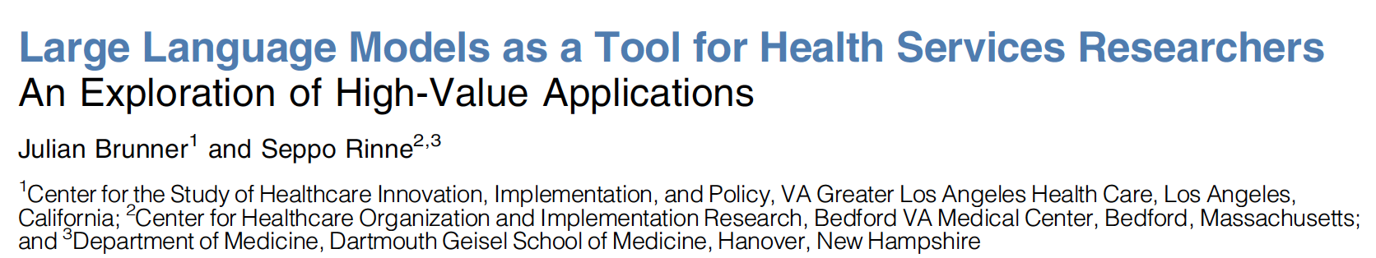
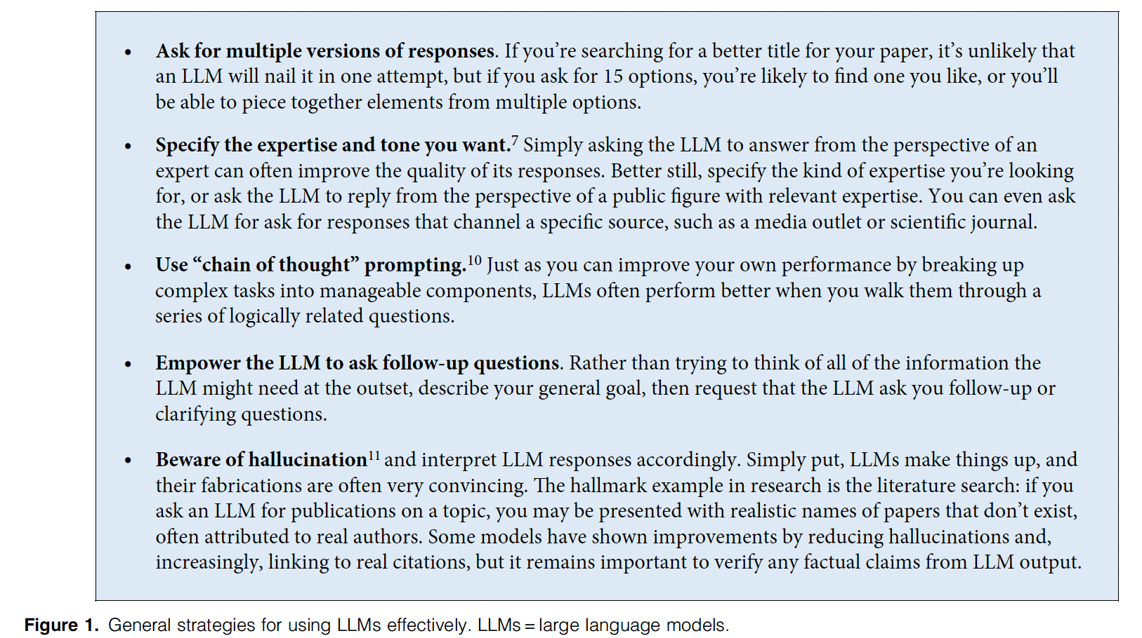

Slide 20
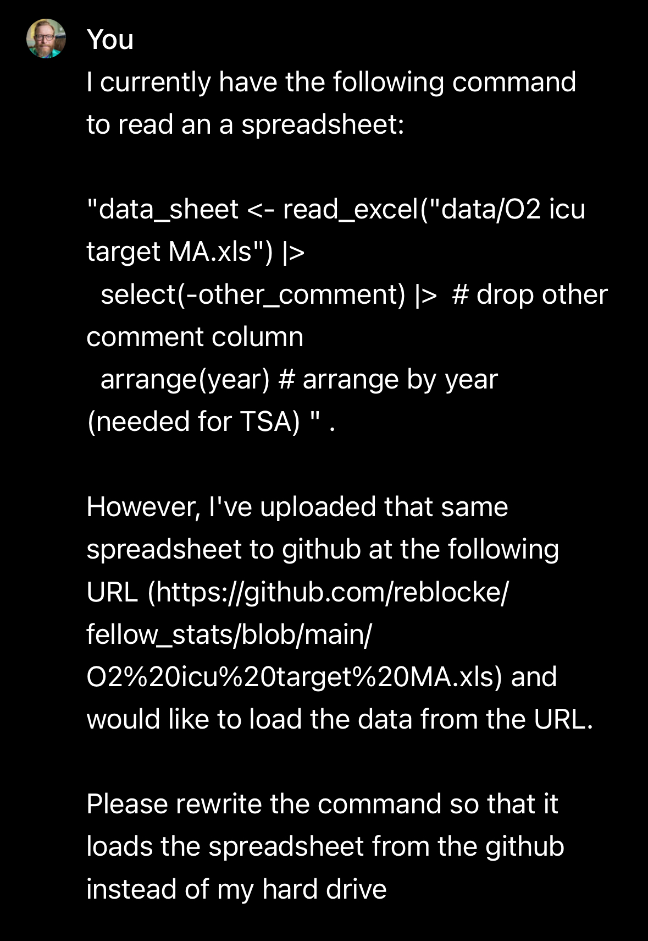
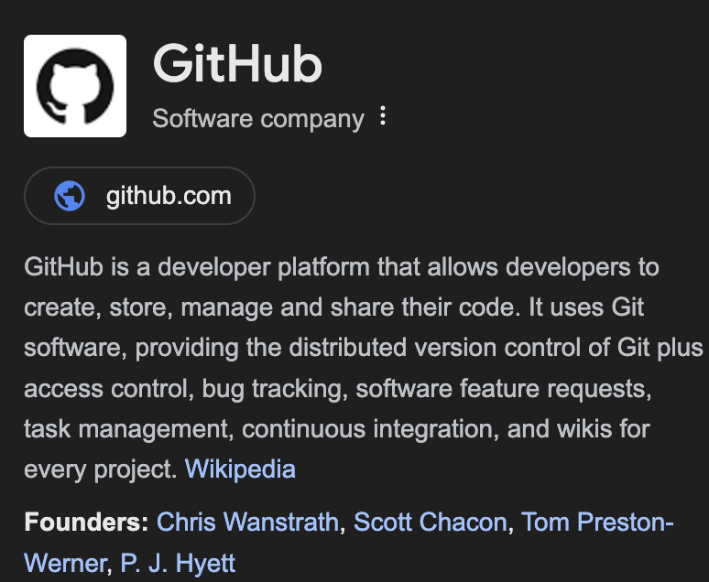
Statistical Coding:

Slide 21
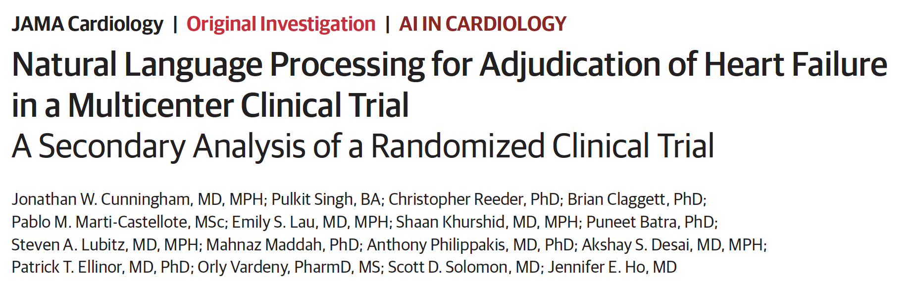
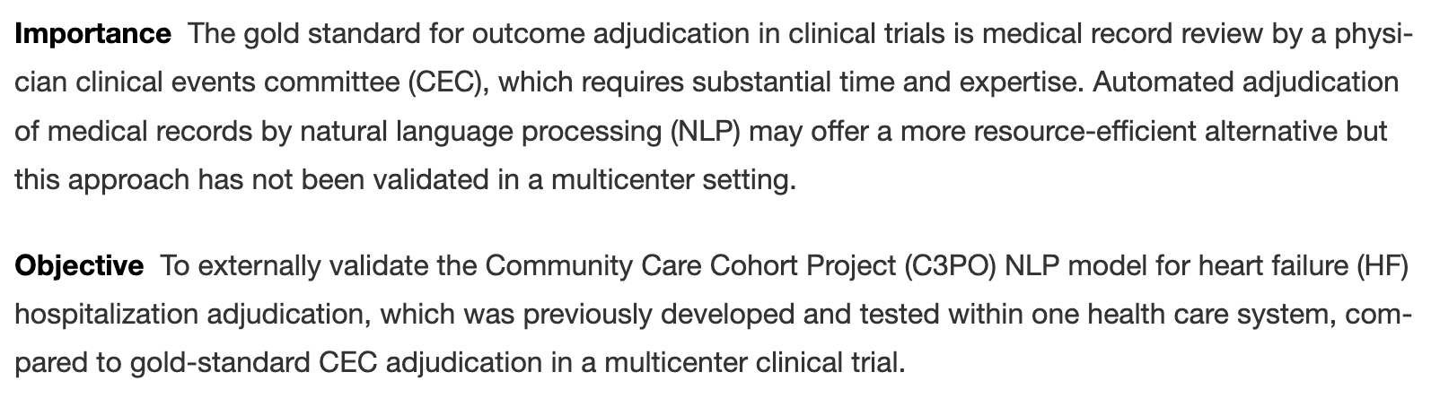
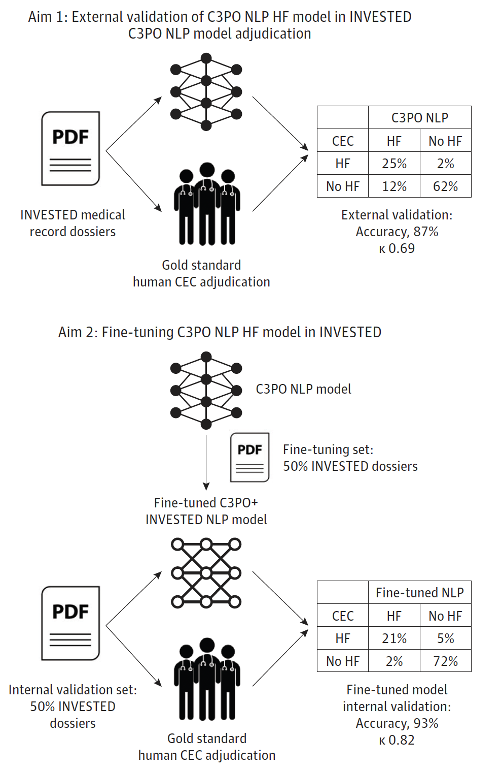
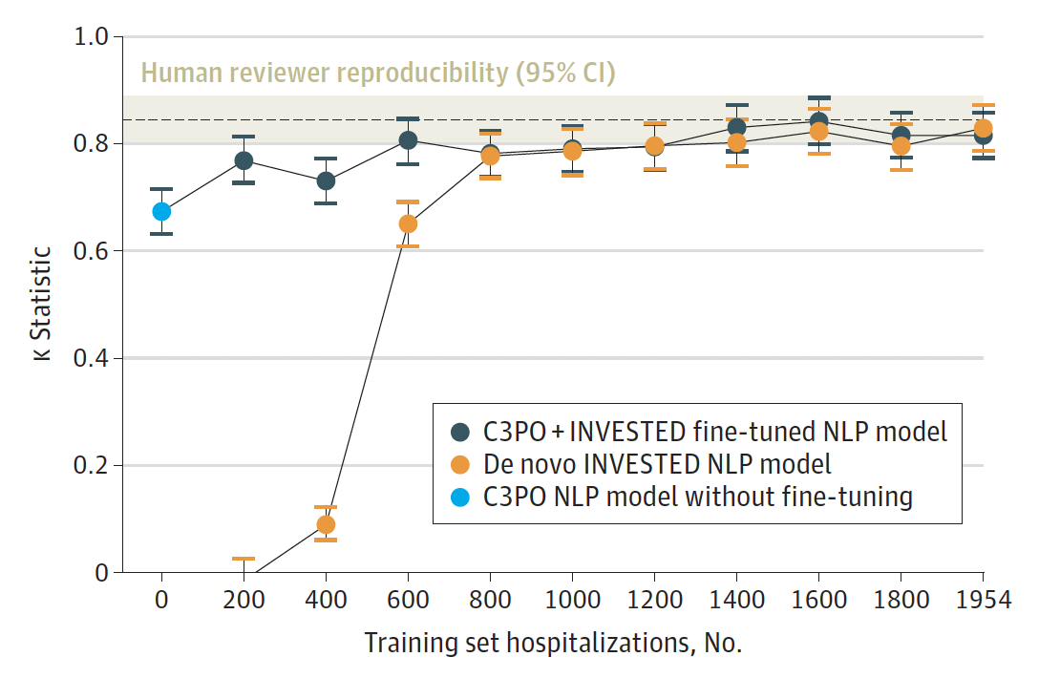
Clinical Research Informatics

Slide 22




Clinical Research Informatics
Goal: Predict who has hypercapnia
Current: use structured data like lab values in a logistic regression
Ideal: extract unstructured data like symptoms to use a predictors
Tasks:
“Did this patient present for confusion?”
“How likely is it this patient has confusion?”
“How likely is it this patient has hypercapnia?”
Evaluation:
How well does the LLM identify patients with confusion (vs. human reader)
Requires annotation of ‘answers’
How much does the LLM improve hypercapnia predictions?
Does not require annotation
ED Triage Notes
(Data must be present when the model runs)
Locally-deployed LLM
Possible tasks*
Use as predictor in diagnostic model

Slide 23


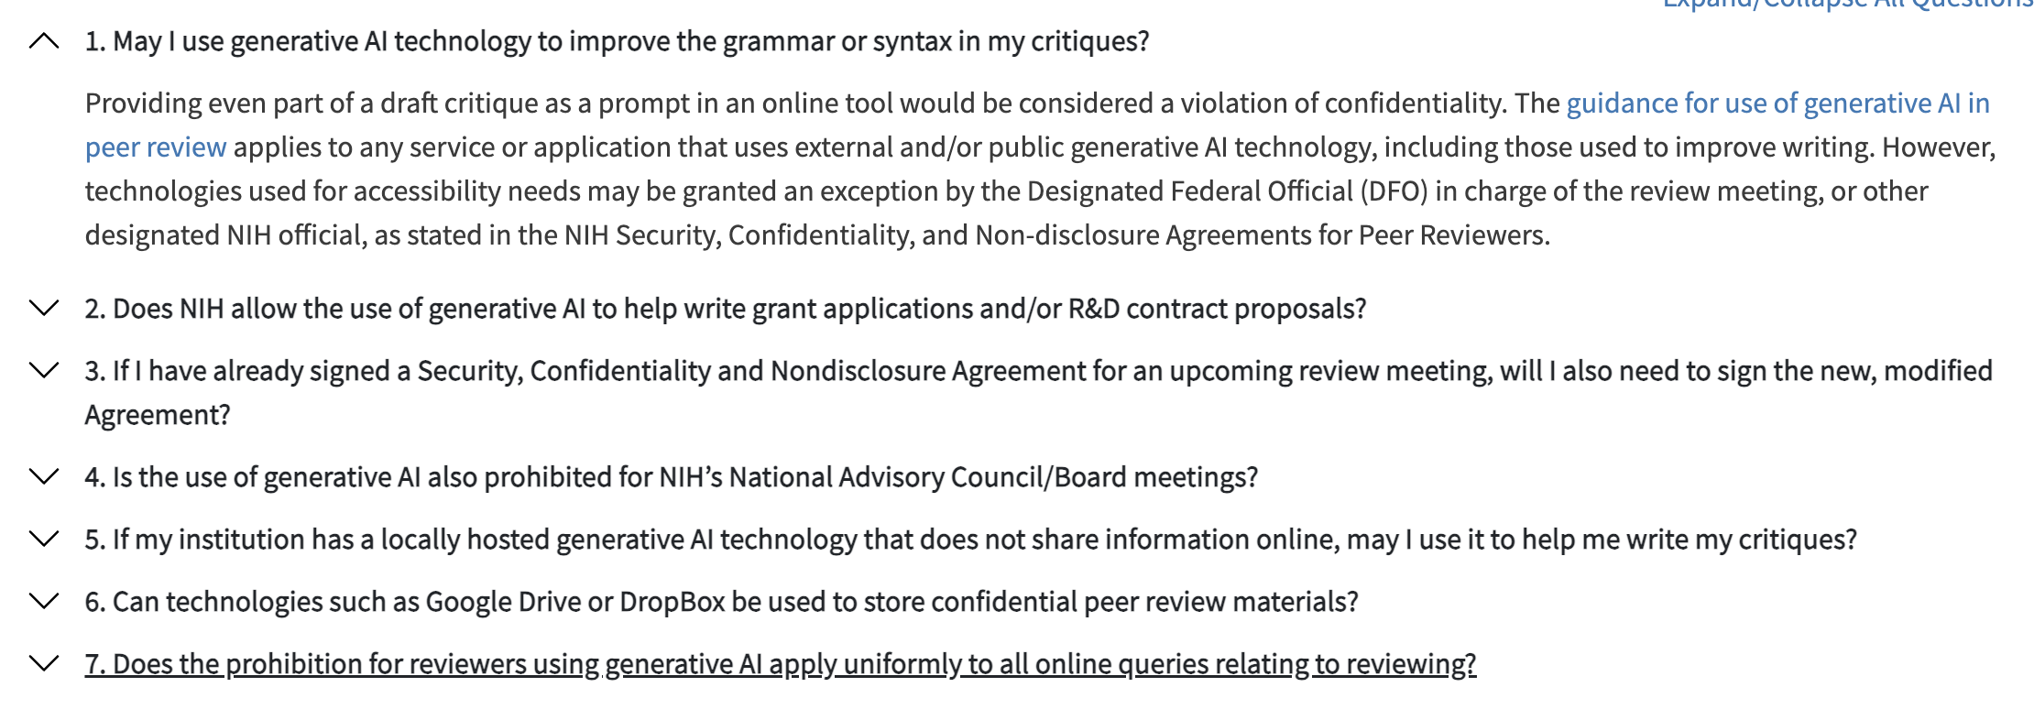
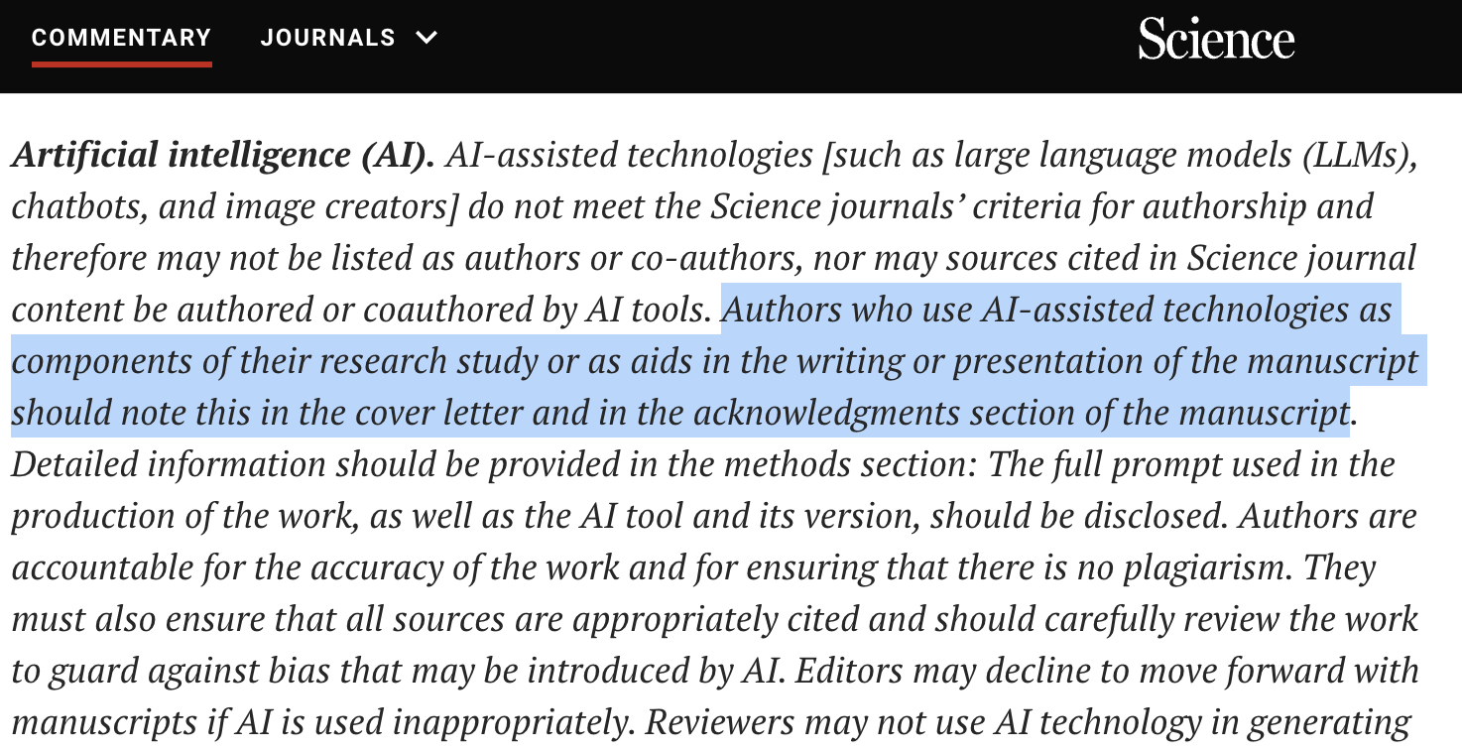
Scientific Writing?
Act like the editor for a popular science publisher.
I need feedback on how to make the following sentence easier to read and less ambiguous.
you will restate the main point of the following sentence (it’s OK to do this in several sentences). Then, give 5 reformulation of the sentence. Each should be in a different style, but all should emphasize clarity.
in the process, you should explain what changes you made. ,
please do not use jargon.
The sentence is for you to rewrite is… “
Notes:
Beware: Policies
NIH
Journals
“Can you help me rewrite the paragraph and finish it by giving me 10 options for the entire paragraph in four professional styles? Make the styles and approaches different from each other, making them extremely well written.”
You are Ozymandias. You are going to help Ethan Mollick write a book chapter on using AI at work. Your job is to offer critical feedback to help improve the book. You speak in a pompous, self-important voice but are very helpful and focused on simplifying things. Here is the chapter so far. Introduce yourself.
[ ] make a writing feedback and writing simplification GPT
***pdf’s of the elements of style? or similar?
what can GPTs do well?. Here’s a list, which we will refine in more detail
below:
● Read, transform and manipulate text
● Improve writing
● Improve coding
● Summarize ideas
● Answer analytical questions with short causal chains
● Solve simple models
● Write exams
● Generate hypotheses and ideas

Slide 24
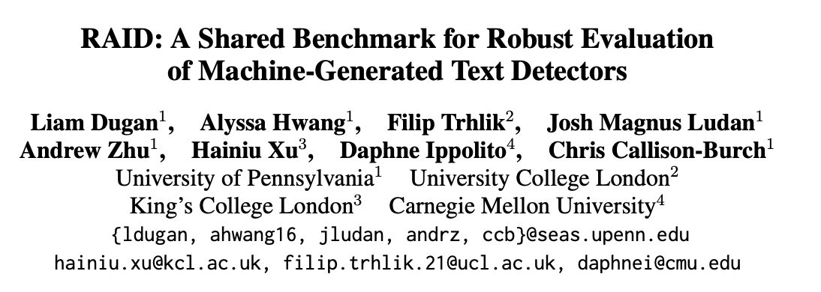
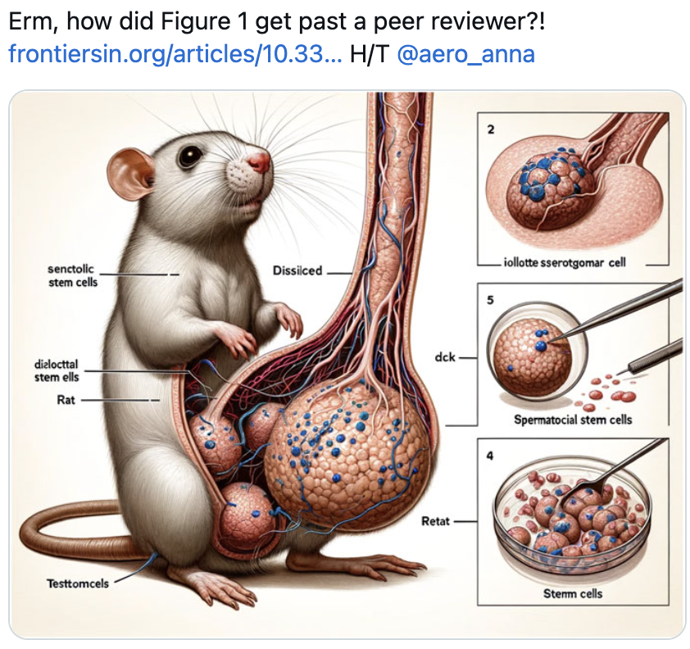
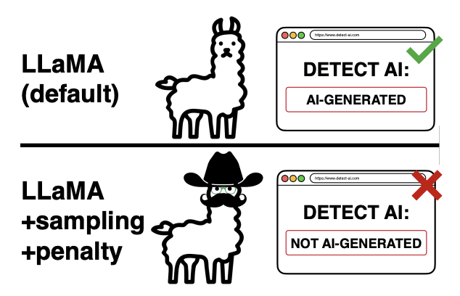
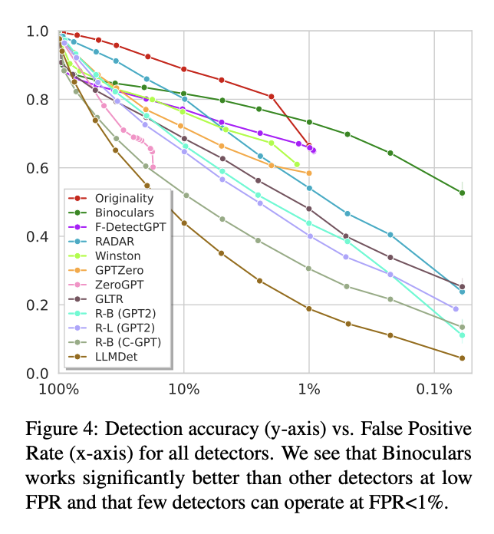

Notes:
https://arxiv.org/abs/2405.07940

Slide 25



Clinical Reasoning
Notes:
https://www.ncbi.nlm.nih.gov/pmc/articles/PMC10714249/

Slide 26



Differential Diagnosis
(Google’s regular LLM)

Slide 27



Fundamental Theory of Informatics… but is it true?
Notes:
Both groups were instructed to access any conventional resources they normally use for clinical care, but the control group was explicitly instructed not to use LLMs.

Slide 28



Slide 29


Notes:
Just a tool
Not going to be replacing us any time soon.

Slide 30




Slide 31



Problem: PHI cannot go to these companies
Leaves protected environment:
need a Business Associate Agreement.
Real issue of consent
Notes:
https://justine.lol/matmul/

Slide 32


How deidentified is deidentified enough?
Full Patient Chart
Description of characteristics?
Fully Anonymized
No
Yes(?)
???

Slide 33




Local deployments
Notes:
—> set up a hugging face model.
Transformers (Encoder-Decoder)-> Encoder(BERT) & Decoder (Large Language Models)

Slide 34
Prompt Engineering:
Zero shot prompting = just ask for the answer out of the blue ”The patient has heart failure and rales. Why is she short of breath?”
N-shot prompting = ask a sequence of questions and rely on in-context learning. “What’s your differential?” ”Why do you think heart failure is most likely?” “What tests would you order?”
Chain of thought prompting: “The patient has xyz medical history and presents with shortness of breath. First, summarize the case, then provide an ordered different diagnosis. Gives pros and cons for each possibility. Then, provide recommendations on which test to order.
Notes:
[ ]add to presentation.
How Weird is prompting? https://www.oneusefulthing.org/p/captains-log-the-irreducible-weirdness
https://platform.openai.com/docs/guides/prompt-engineering
Use “chain of thought” prompting.10 Just as you can improve your own performance by breaking upcomplex tasks into manageable components, LLMs often perform better when you walk them through aseries of logically related questions.
Zero-shot prompting: A technique in which language prompts are used to get a model to perform specific tasks without having seen explicit examples of those tasks.
Few-shot prompting: A technique in which the model is provided with some examples of the task, hence the name “few.”
Chain-of-thought prompting: A technique in which a sequential series of intermediate logical steps toward arriving at the problem is provided to the language model. This has been shown to be useful in numerical problems. An example would be, “Let us think step-by-step like a physician/cardiologist/rheumatologist.”

Slide 35
Prompt engineering is hard
Act like an expert diagnostician,
I need a prioritized differential diagnosis that includes all of the likely diagnoses and all the diagnoses it would be important not to miss,
you will first generate a list of the most likely diagnoses, you will then order them from most to least likely, then you will give a probability for each,
in the process, you should consider all the most likely or dangerous diagnoses. Consider the pretest probability of each diagnosis, then modify it by the cumulative strength of evidence to get a final probability.
please Prioritize accuracy.,
input the final result in a list format, with percentage likelihoods and a short explanation,
here is an example: [Enter an example].
Here is the case: …
Act like a [Specify a role],
I need a [What do you need?],
you will [Enter a task],
in the process, you should [Enter details; often in a chain of steps],
please [Enter exclusion],
input the final result in a [Select a format],
here is an example: [Enter an example].
Notes:
Stop writing your prompts from scratch. https://hbsp.harvard.edu/inspiring-minds/an-ai-prompting-template-for-teaching-tasks
Prompting intro: (https://www.promptingguide.ai/)
why does it matter?
Temperature / stochastic
What are some of the main resources?
Examples: prompting -
https://www.nature.com/articles/s41746-024-01010-1/tables/2
Easy approaches:
“IMO you only need to know three prompt engineering techniques, and they fit in half a tweet.
1. Show the model examples
2. Let it think before answering
3. Break down big tasks into small ones
Beyond that, it's all about fast iteration loops and obsessing over every word.”
Act like a [Specify a role],
I need a [What do you need?],
you will [Enter a task],
in the process, you should [Enter details],
please [Enter exclusion],
input the final result in a [Select a format],
here is an example: [Enter an example].
How can they be used In clinical Medicine?
[ ] prompt guide https://readwise-assets.s3.amazonaws.com/media/wisereads/articles/prompting-guide-101/gemini-for-google-workspace-prompting-guide-101.pdf
https://docs.anthropic.com/en/docs/intro-to-claude
When asking GPTs a question, we have several pieces of advice, namely:
1. Surround your question with lots of detail and specific keywords - these don’t have to be structured properly.
e.g. “Eiffel tower,
next to the reflecting ocean, nighttime, by Vladimir
Volegov and Philipp A. Urlich and Pengzhen
Zhang and Andreas Rocha, fantasy, intricate,
elegant, highly detailed, digital painting, artstation,
blender, unreal engine 5, octane render, smooth,
sharp focus”
2. Make your question sound smart, and ask for intelligence and expertise in the
answer
3. Ask for answers in the voice of various experts.
[ ] who is a good scientist to use here? Roy G Brower; Richard Light; Ivor Douglas
4. Ask for compare and contrast.
5. Have it make lists
6. Keep on asking lots of sequential questions on a particular topic.
7. Ask it to summarize doctrines
8. Ask it to vary the mode of presentation
9. Use it to generate new ideas and hypotheses
Give do’s and don’ts.

Slide 36

Summary?
For this invention will produce forgetfulness in the minds of those who learn to use it, because they will not practice their memory. Their trust in writing, produced by external characters which are no part of themselves, will discourage the use of their own memory within them.
-Socrates, on writing
You should probably be using these tools
It takes skill to use them well
They are not infallible and raise tricky issues
Notes:
Thirunavukarasu AJ, Ting DSJ, Elangovan K, et al. Large language models in medicine. Nat Med. 2023;29(8):1930-1940
https://academic.oup.com/eurheartj/article/45/5/332/7505599

Slide 37




Notes:
https://ai.nejm.org/doi/full/10.1056/AIpc2300038

